Slide 1


DISCOVERY PRIMARY CARE
Graduate project
JUNE 2019

Slide 2
DISCOVERY PRIMARY CARE | PURPOSE
Building Discovery Primary Care into an inclusive ecosystem that is scalable and sustainable – focused on quality, efficiency, brilliant experience and the best value for money
  DISCOVERY PRIMARY CARE | Where private healthcare is valued, accessible and inclusive

Slide 3
DISCOVERY PRIMARY CARE | THE PRODUCT
Discovery Primary Care is a unique healthcare product that enables employers to provide their employees and their families with affordable quality private healthcare and wellness management
Employers can cover their employees with Discovery Primary Care from R171 per month
Discovery Primary Care has two benefit options which allows employers to choose the best option for their employees
The two benefit options are:
  Primary Care Activate
    Basic benefit offering
  Primary Care Advanced
    A more comprehensive offering with benefits over and above those offered on Primary Care Activate
Employers can choose to add the Trauma Benefit to either of these benefit options

Slide 4

DISCOVERY PRIMARY CARE | BENEFITS FOR EMPLOYERS

Slide 5
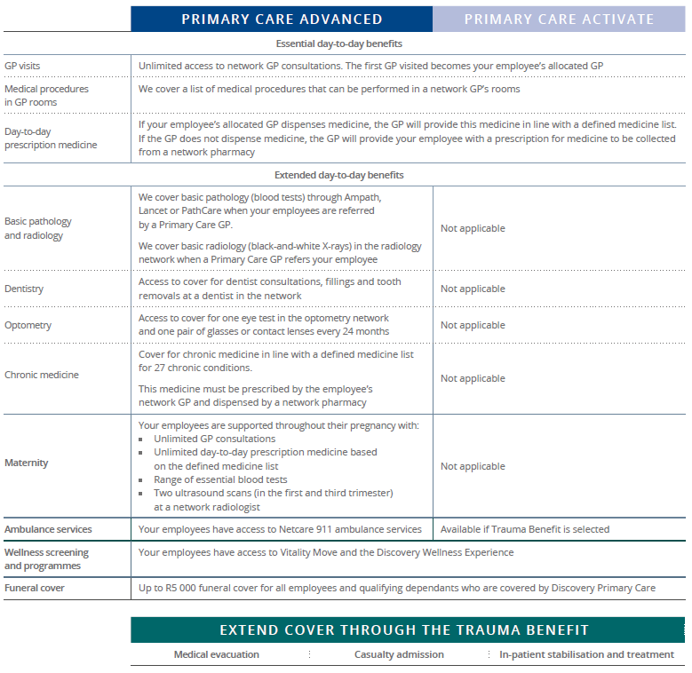

DISCOVERY PRIMARY CARE | BENEFIT OPTION COMPARISON
Extended cover through the Trauma Benefit

Slide 6




DISCOVERY PRIMARY CARE | MEMBER STATS
45 744 lives
EMPLOYERS BY INDUSTRY
FULL CIRCLE CONTACT CENTRE SERVICES | 2025
CURRO HOLDINGS | 1894
UNIVERSITY OF KWA-ZULU NATAL | 1218
AMROD CORPORATE SOLUTIONS | 1203
SERVICES | 104
RETAIL | 34
PROFESSIONAL SERVICES | 26
MANUFACTURING & MINING | 15
TECHNOLOGY | 9
FINANCIAL SERVICES | 7
UNKNOWN | 4
EDUCATIONAL SERVICES | 3
TOURISM & LEISURE | 3
AGRICULTURE | 2
MARKETING & MEDIA | 2
210 employers
CLICKS GROUP SOUTH AFRICA | 11097
PARMALAT SA (PTY) LTD | 1181
COTTON ON SOUTH AFRICA PTY LTD | 602
Employers range from 3 to +11 000 members
INNOVATIVE STAFFING SOLUTIONS | 644
INTERCARE MANAGED HEALTH CARE | 412
OMNIA HOLDINGS LIMITED | 2511
JDG TRADING (PTY) LTD | 515
COMMUNICATION CHANNELS RATIOS
TOP 5 REASONS MEMBERS CALL DISCOVERY PRIMARY CARE
1. Requesting a membership card
2. Finding a provider
3. Updating their details
4. Confirming membership details
5. Requesting membership certificate
77%
13%
+
12%

Slide 7
DISCOVERY PRIMARY CARE | PROJECT
BUSINESS PROBLEM
Members are not aware of the benefits of their Discovery Primary Care plan and consistently call into the call centre for information
Source
Visit the Discovery website: https://www.discovery.co.za/portal/business/primary-care
THE PROJECT
After reviewing the research presented and source supplied, you are required to present a communications strategy to solve the business problem.
Contact
Bronwyn Bailey: bronwynb@discovery.co.za
Tips:
Individuals cannot buy Discovery Primary Care- only an Employer can buy Discovery Primary Care for their staff
Discovery Primary Care is not medical aid, it is a medical insurance product based on a specific benefits
Discovery Primary Care offers medical cover to people who are unable to afford medical cover
Limited channels available to communicate to members

