Slide 1
Graduate Programme Brief
Discovery Vitality Marketing
Vitality HealthyDining
Notes:
CHECK ALL HEADERS

Slide 2







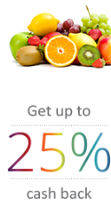




Discovery Vitality’s nutrition strategy
Vitality’s nutrition strategy aims to prevent and manage lifestyle diseases and its associated long-term health complications by influencing behaviour related to food choices and eating patterns. We focus on three key pillars, in order to improve one’s nutrition:
BUY
COOK
EAT
BUY
BETTER.
Do you know what food you should be buying in the shops?
COOK
MORE OFTEN.
Who is cooking your food and how often are you cooking at home?
EAT HEALTHIER.
When you’re not eating at home, are you making the smartest choice?
HealthyFood Benefit
Vitality HealthyFood Studio
HealthyDining Benefit

Slide 3
Background
Why Vitality HealthyDining ?
Due to our busy modern lives, more and more people are relying on convenience meals, fast foods and restaurant meals instead of home-cooked meals.
This means that many people are filling up on energy-dense and processed foods high in salt, sugar and refined carbohydrates – putting our health at risk by increasing the chances of unhealthy weight gain and of developing health conditions such as high blood pressure or type 2 diabetes.
We’ve launched Vitality HealthyDining to help our members identify and draw their attention to healthier meal choices when eating out or ordering in with Uber Eats.
We aim to make healthier choices more affordable by offering up to 25% cash back (plus 50% cash back for Vitality's healthy kids' meals for children under the age of 12). In the process, we’re also educating our members and their children on healthy choices when eating out.
We’ve partnered with four popular restaurant chains – Col’Cacchio, Doppio Zero, Ocean Basket, Nando’s – and Uber Eats to bring our members Vitality HealthyDining.

Slide 4
The challenge
The Brief
Coming soon is the launch of Vitality HealthyDining in-resturants with our selected restaurant partners. The task would be to create an integrated marketing campaign that would entrench Discovery Vitality as a powerful enabler of healthy behaviour change with our members and non-members, within the partner restaurant sit down experience.
What does success look like?
To increase brand awareness of the Vitality HealthyDining benefit within our target market by 10% over the campaign period (3 month period), measured by new Vitality member sign ups and activations of the benefit.
Increase foot traffic by 10% for all Vitality HealthyDining restaurant partners, to make the product is mutually beneficial and ensure sustainability for the Vitality HealthyDining benefit.
Target Audience focus: Vitality members (activations), non- Vitality members(sign-ups) and kids (starting with healthy habits at a young age).

Slide 5
SMART Marketing Goals
KEY QUESTIONS
Grow Vitality
Attract new
Vitality
members
How will you not only get activations of the benefit, but use the benefit as a leverage to get more Discovery Vitality members?
Drive
engagement and dazzle members
Engage the unengaged, recognise the engaged
How will your campaign get members to do their Vitality Healthy Check and Vitality Age Assessment to increase their cash back?
How will you reward good behaviour?
VITALITY MARKETING FOCUS AREAS
APPLIED TO VITALITY HEALTHYDINING
Increased
brand
visibility
Create a
visible brand
presence
How will you make sure the Vitality brand becomes iconic in the restaurant space, allowing the “healthier choice” to be a no brainer ?
Make SA
healthier
Drive awareness through thought leadership campaigns
How will your campaign make Discovery Vitality a pioneer when it comes to eating out in the various restaurant spaces, the healthy way?

Slide 6

The benefit explained in 10 seconds …
Product wording that we have been following:
Discovery Vitality members get up to 25% cash back on healthier meal choices and 50% cash back on Vitality kids’ healthy meals.
PRESS PLAY

Slide 7
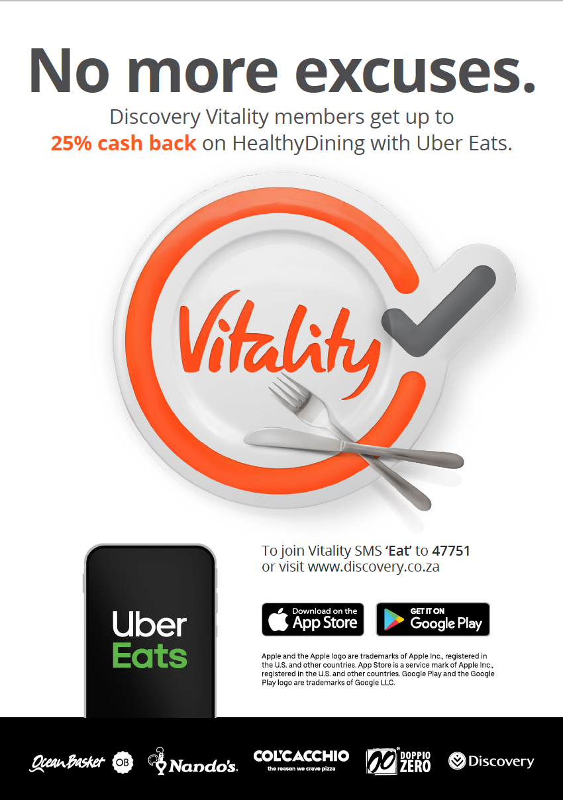
What's been done so far ?
The launch of Vitality HealthyDining with Uber Eats
VITALITY INDICATOR
HERO IMAGE
IN UBER EATS APP
Making Vitality the hero of every marketing piece.
Making sure that our indicator becomes iconic and guides members make the right healthy meal choices.
The Uber Eats app is one of the most powerful ways to get in front of thousands of potential new Vitality members.

Slide 8
Good luck!
Who to contact for help
Celeste Williams
Head of Marketing: Discovery Vitality
CelesteW@discovery.co.za
Kristy Cunningham
Senior Marketing Manager: Discovery Vitality
kristyc@discovery.co.za
Notes:
CHECK ALL HEADERS

