Slide 1



Slide 2
Table of contents
Asset Class Performance to 30 September 2025
SA Equity Performance to 30 September 2025
Commodities Performance to 30 September 2025
Global Market Performance to 30 September 2025
SA Markets
Resources vs Financials vs Industrials
Earnings per share and price-earnings ratios
South African Volatility Index (SAVI)
Exchange Rate overview (CPI - Best Fit)
Interest rates and bond yields
Bond Yields
Equity Yields vs Interest Rates
MSCI vs Earnings
MSCI EM vs Earnings
Global Markets Overview
MSCI Relative Price-Earnings Ratios (Trailing)
MSCI and SWIX Relative Price-Earnings Ratios (Trailing)
Global market volatility
Global Bonds
SA Rand against the US Dollar, Pound & Euro (12 months)
SA Rand against the US Dollar, Pound & Euro (5 years)
Exchange Rates (USDZAR)
Exchange Rates (GBPZAR)
Exchange Rates (EURZAR)
SA equities vs. global developed & emerging markets (12 months)
SA equities vs. global developed & emerging markets (5 years)
US Institute for Supply Management Index
SA Purchasing Managers Index
Gold Price (USD)
Brent Crude Price per Barrel (USD)
Platinum Price (USD)
Conclusion
Disclaimer

Slide 3
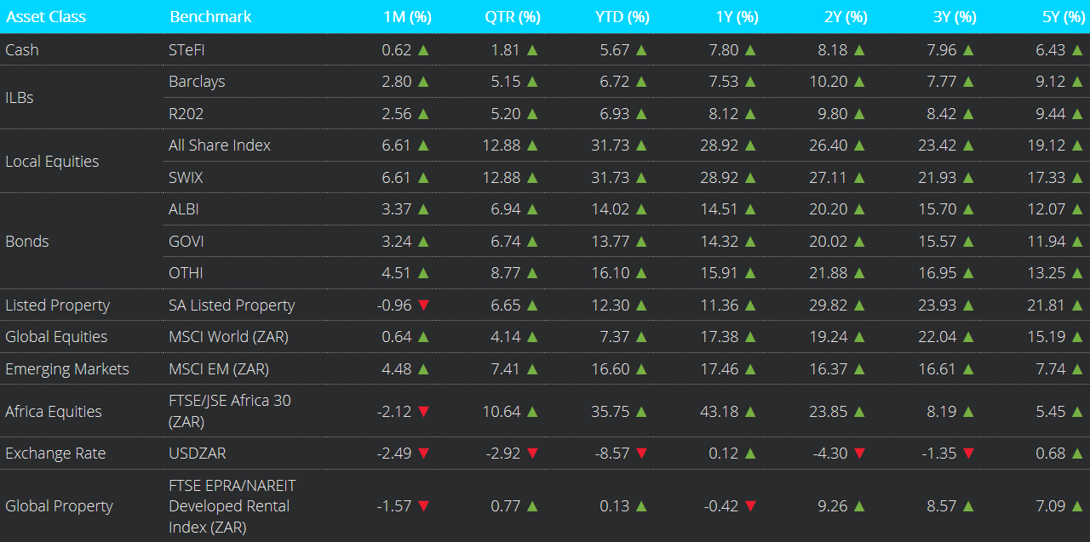
Asset Class Performance to 30 September 2025
Notes:
Global equity markets delivered strong returns in September, reversing typical seasonal weakness. The MSCI World Index rose 3.2% (in USD), while the MSCI Emerging Markets Index gained 7.2% (in USD) for the month of September. Investor sentiment was buoyed by the US Federal Reserve’s first rate cut of the year. Volatility eased, with the VIX falling below 16.3 at month-end from over 17 at the start of the month.
On a total return basis, SA inflation-linked bonds and nominal bonds were up in September.
The ALBI strengthened by +3.4%, while inflation-linked bonds as measured by the Barclays ILB index increased by 2.8%.
South African listed property dropped by -0.96%.
In Rand terms, Developed Market (DM) Equities rose +0.6%, and Emerging Market (EM) Equities rose by +4.5%.
Africa Equities, in Rand terms, dropped by -2.1%.
The USD/ZAR exchange rate ended the month at R17.25

Slide 4
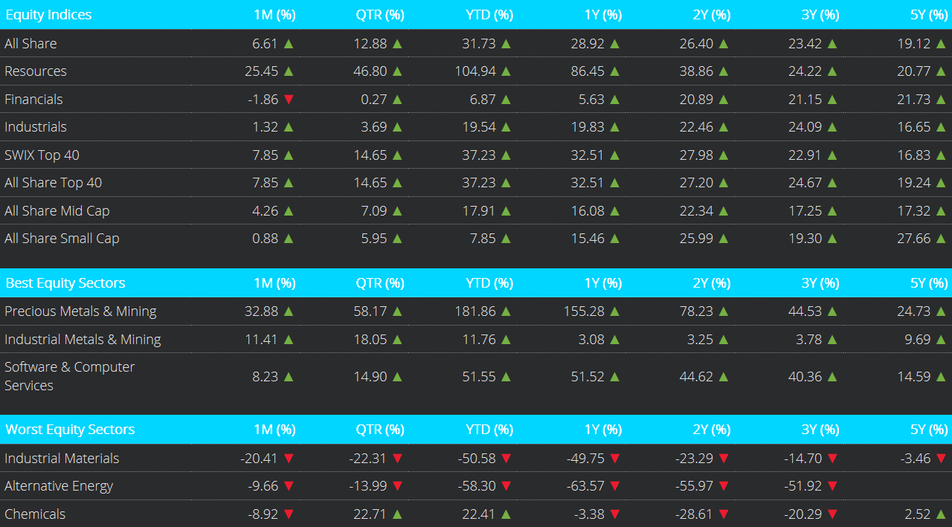
SA Equity Performance to 30 September 2025
Notes:
From a market’s perspective, South African equities as measured by the FTSE/JSE All Share Index posted a gain of 6.6%.
Within equities; Resources gained +25.5%, Industrials gained +1.3%, whilst Financials dropped -1.9%.
On a market capitalisation basis, the All Share Top 40 gained the most, increasing by +7.9%, followed by the All Share Mid Cap Index (+4.3%), whilst the All Share Small Cap +0.9%.

Slide 5
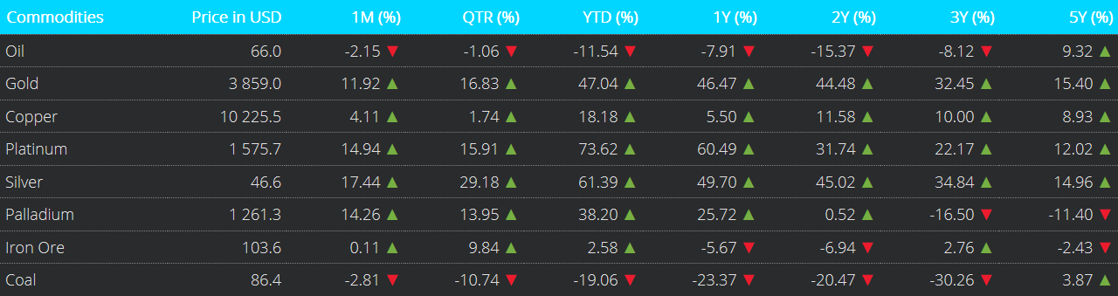
Commodities Performance to 30 September 2025
Notes:
Precious metals had a mixed month of performance.
September saw a Palladium rising by +14.3% and Platinum increase by +14.9%.
Gold gained +11.9%, Silver gained +17.4% and Copper gained +4.1%.
The oil price decreased by -2.2%, and on a 12-month basis, it is now -11.5% lower.
Lastly, the Coal price decreased by -2.8%.

Slide 6
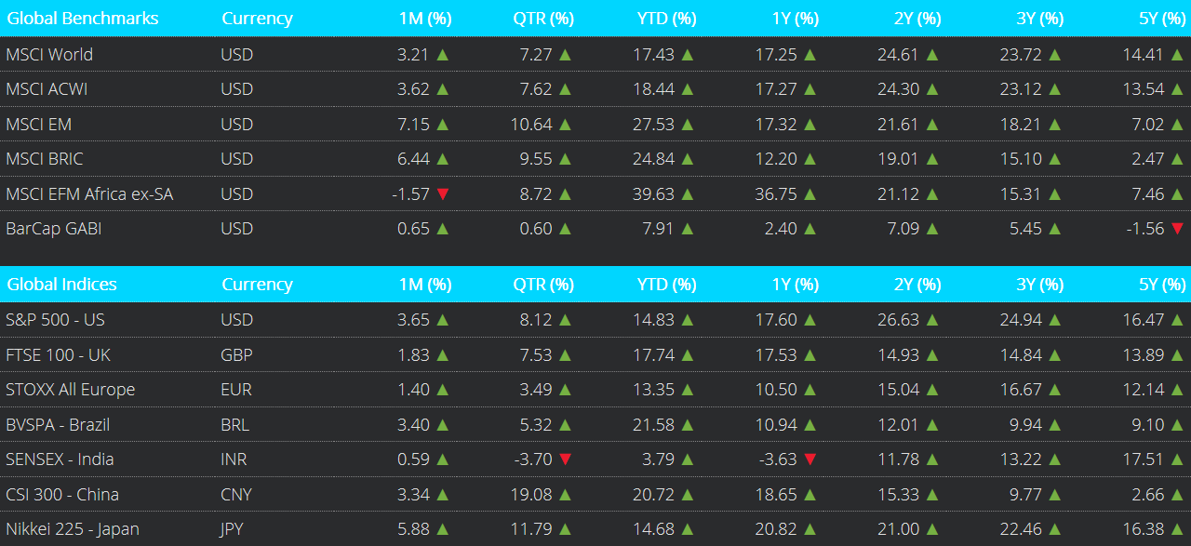
Global Market Performance to 30 September 2025
Notes:
In September, The MSCI World and MSCI All Country World Index (ACWI) both rose by +3.2% and +3.6% respectively, while the MSCI Emerging Markets Index outperformed, gaining +7.2% in USD terms.
In China, the Caixin Manufacturing PMI improved slightly to 51.2 in September from 50.5 in August. This marked the highest reading since March.
The NASDAQ 100 posted an increase of +5.4% with the broader S&P 500 index increasing by +3.7%.
UK equities, FTSE 100, closed higher by +1.8%.
The broader European index, STOXX All Europe, was up by +1.4%.
The Nikkei 225 was up +5.9%.
Brazil's BVSPA (Ibovespa) increased by +3.4%. Meanwhile, China's CSI 300 index gained+3.3% , as well as India's SENSEX index by +0.6% .

Slide 7
SA Markets
Notes:
The FTSE/JSE All Share Index closed +6.6% higher in September. On a 12-month basis, it has increased by +28.9%.

Slide 8
Resources vs Financials vs Industrials
Notes:
This chart shows the performance of three key South African sector indices: the Resources, Financials, and Industrials.
For the month of September, Resources gained +25.5%, Industrials registered a gain of +1.3%, whilst Financials decreased by -1.9%.
Across these sectors, Resources was the best-performing sector on a 12-month basis, returning +86.5%. This was followed by Industrials, which gained +19.8%, and Financials, which was up +5.6%.

Slide 9
Earnings per share and price-earnings ratios
Notes:
This chart compares the cumulative return of the All-Share Index, as shown by the yellow line, to its cumulative earnings per share, as shown by the red line.
Earnings per share increased and remained above the All-Share index as at the end of September. The All-Share Index continues to appear attractive on a price-to-earnings valuation basis .

Slide 10
South African Volatility Index (SAVI)
Notes:
The South African Volatility Index (SAVI) is a key financial metric used to gauge market sentiment and expected risk in the South African equity markets.
The SAVI saw a decrease in the index from 16.11 in August to 14.82 in September.
This likely reflects that investors are pricing in lower levels of uncertainty regarding the future path of equity prices.

Slide 11
Exchange Rate overview (CPI - Best Fit)
Notes:
This chart compares the effective Rand-Dollar exchange rate as shown by the yellow line to the Purchasing Power Parity (PPP) Rand-Dollar exchange rate as shown by the red line, which is calculated with Consumer Price Inflation, on a best-fit basis.
Using this lens through which to value the Rand against the US Dollar, the local currency remains heavily undervalued.
The PPP-implied exchange rate is approximately R11.40 per USD while the actual exchange as at end September was R17.25 per USD

Slide 12
Interest rates and bond yields
Notes:
In September, the repo rate remained at 7.0%.

Slide 13
Bond Yields
Notes:
The yield on the nominal 2-year R186 bond was 7.46% at the end of September, with longer-dated yields, such as the R2048, expiring in 23 years, posting 10.32% for the month.

Slide 14
Equity Yields vs Interest Rates
Notes:
This chart depicts equity earnings yields, shown by the yellow line, relative to bond yields as shown by the red line. ​
​
In September, the R186 bond yield decreased, and equity yields decreased. The R186 bond continues to offer higher yields than the FTSE JSE All-Share Index, reflecting better relative value. However, the gap between bond and equity yields has expanded, making the advantage more pronounced than in prior years.

Slide 15
MSCI vs Earnings
Notes:
This chart compares the MSCI World Index, Developed Markets, price growth with the earnings growth of the underlying companies within the index over time.
The price index continues to rise as US tech companies lead the way, with an upward jump movement over August.
The earnings of the index has remained relatively stable over the past 12-18 months, with a more recent uptick from November.

Slide 16
MSCI EM vs Earnings
Notes:
This chart compares the MSCI Emerging Markets Index price growth with the growth of its earnings per share over time.
The price growth continued in September, complemented by a slight decrease in earnings per share.

Slide 17
Global Markets Overview
Notes:
This chart depicts the long-term performance of various MSCI indices.
The long-term trend remains in place: Developed and Emerging Markets outperform Frontier and Emerging Frontier African markets.
For the approximate 16-year period under consideration, the Frontier Markets and the Africa ex. SA indices have been flat-to-negative, though in recent months, Frontier Markets returns have turned positive

Slide 18
MSCI Relative Price-Earnings Ratios (Trailing)
Notes:
In this chart, we depict the price-earnings or PE ratios for various MSCI Indices using the past 12 months' earnings, i.e., trailing earnings.
In September, MSCI EFM Africa ex-ZA, and MSCI FM P/E ratios decreased, while the MSCI World , and MSCI EM P/E ratios increased.

Slide 19
MSCI and SWIX Relative Price-Earnings Ratios (Trailing)
Notes:
Here we depict the trailing price-earnings or PE ratios for the various MSCI Indices shown in the previous slide and now include the SWIX index as shown by the blue line.
As shown, the SWIX’s P/E ratio has broadly moved in line with the MSCI Frontier Markets Index over time, although it remains somewhat lower at present. When compared to the MSCI Emerging Markets Index, the SWIX currently trades at a discount, suggesting relatively cheaper valuations in the South African equity market.

Slide 20
Global market volatility
Notes:
The VIX, a real-time index that tracks market sentiment (fear and greed) relating to the S&P 500.
A low VIX typically implies less market uncertainty, and improved investor confidence in the short-term.
A rising and/or high VIX reading implies the opposite.
The VIX increased over the month, from 15.36 in August to 16.28 in September.

Slide 21
Global Bonds
Notes:
The Bloomberg Barclays Global Aggregate Bond Index (BarCap GABI) increased by +0.7% in USD terms in September
On a 12-month view, it has increased by +2.4%.

Slide 22
SA Rand against the US Dollar, Pound & Euro (12 months)
Notes:
This chart depicts the performance of the South African Rand against the US Dollar, Great British Pound and the Euro over the 12 months to end of September 2025.
During September, the Rand strengthened against all three major currencies, the Dollar, Pound, and Euro. However, on a 12-month basis, it remains weaker relative to the Pound and Euro, while showing a broadly firmer trend against the US Dollar.

Slide 23
SA Rand against the US Dollar, Pound & Euro (5 years)
Notes:
This chart shows the 5-year performance of the local currency against the US Dollar, Pound and Euro.
Over this period, the Rand has depreciated against all three major currencies, reflecting a generally weaker trend in the local currency over time.

Slide 24
Exchange Rates (USDZAR)
Notes:
This chart depicts the long-term performance of the Rand/US Dollar exchange rate.
The local currency appreciated by 2.5% against the US Dollar in September; it is 0.1% weaker against the US Dollar relative to 12 months ago.

Slide 25
Exchange Rates (GBPZAR)
Notes:
The long-term performance of the Rand/British Pound exchange rate.
The local currency appreciated by 3.2% against the British Pound in September; it is 1.7% weaker against the British Pound relative to 12 months ago

Slide 26
Exchange Rates (EURZAR)
Notes:
Long-Term EUR/ZAR Performance
The South African Rand appreciated by 1.7% against the Euro in September. Over the last 12 months, the Rand is 5.7% weaker versus the Euro.

Slide 27
SA equities vs. global developed & emerging markets (12 months)
Notes:
This chart depicts the 12-month performance of the All-Share Index, MSCI World and the MSCI Emerging Markets Indices in Rand terms.
The All-Share Index boasts the highest gain relative to the MSCI World and Emerging markets over a 12-month period.

Slide 28
SA equities vs. global developed & emerging markets (5 years)
Notes:
This chart shows the performance of the indices shown in the previous slide over the five years ending September 2025.
In this time frame, the MSCI EM Index is the relative laggard.
The All-Share Index continues to lead in Rand terms.

Slide 29
US Institute for Supply Management Index
Notes:
The US ISM Manufacturing PMI increased slightly from 48.7 in August to 49.1 in September.
A reading of this index of 50 or above implies economic expansion, while a reading of below 50 implies economic contraction.
This means that the manufacturing segment of the US economy remains in an economic contraction phase.

Slide 30
SA Purchasing Managers Index
Notes:
The seasonally adjusted Absa Purchasing Managers’ Index (PMI) rose to 52.2 in September from 49.5 in August, the highest since October last year, pointing to a renewed expansion in factory activity. This indicates an improved manufacturing activity in September.
A reading of this index of 50 or above implies economic expansion, while a reading of below 50 implies economic contraction.

Slide 31
Gold Price (USD)
Notes:
The price of Gold increased in September, closing the month at $ 3 858.96 per ounce, an incline of +11.9% over the month.

Slide 32
Brent Crude Price per Barrel (USD)
Notes:
The price of Brent Crude Oil decreased by –2.1% in September, closing the month at $66.03 per barrel.

Slide 33
Platinum Price (USD)
Notes:
The price of Platinum increased by +14.9% in September, closing the month at $1 575.69 per ounce.

Slide 34
Conclusion

Slide 35
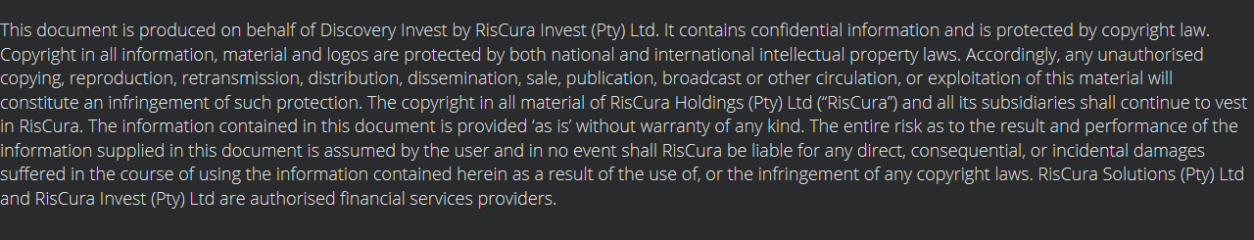
Disclaimer

