Slide 1
BUILDING A BETTER HEALTHCARE SYSTEM
DEON KOTZÉ | CHIEF PRODUCT OFFICER

Slide 2





Access to primary healthcare is highly valued
LOW INCOME HOUSEHOLDS USE PRIMARY HEALTHCARE CHANNELS WHEN SEEKING CARE
HOUSEHOLDS EXPERIENCE SUBSTANTIAL CHALLENGES WHEN ACCESSING CARE
HOUSEHOLDS REGULARLY USE THEIR HEALTHCARE BUDGET ON PRIMARY SERVICES
~80%
of low income earners seek primary healthcare within the first 48 hours of experiencing any symptoms¹
Employees access care through public clinics and self-funded private facilities¹
~97%
of healthcare budget spent on medication and private doctor consultations
~65%
Public clinics
~21%
Private doctors
Queues
70%
Self-fund care no medical aid or employer subsidies²
Transport
<24 hours
48 hours
Regular activities stopped
Many activities stopped
Last resort
Quality of care
Research shows preference to self-medicate to avoid access and affordability constraints¹
Time to Seeking Care
1M4JAM Discovery Research – September 2020
22020 General Household Survey

Slide 3
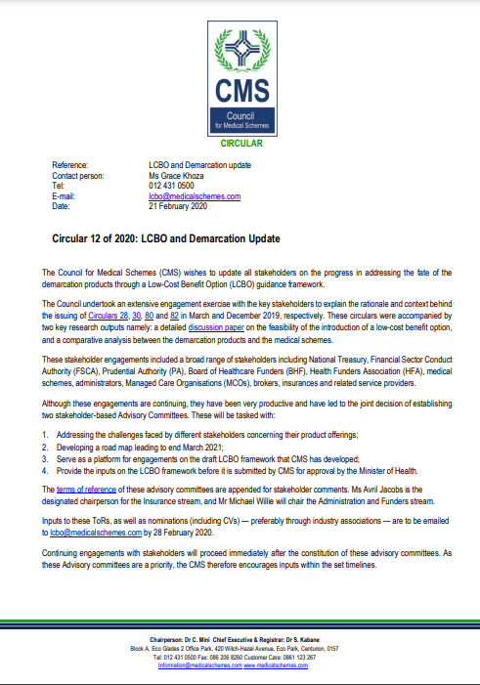
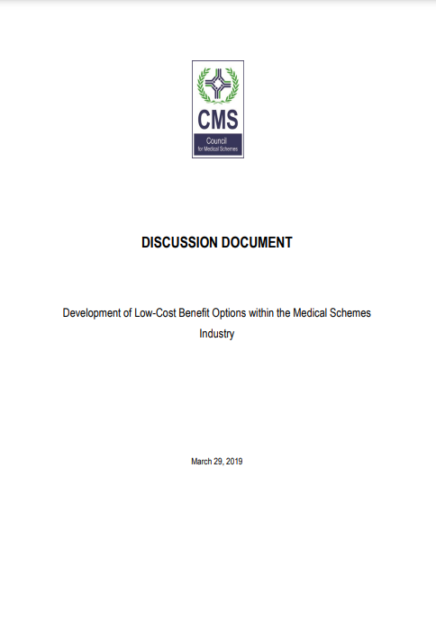
LCBO FRAMEWORK|NHI implementation WILL LIKELY BE incremental & long-term; LCBOs present an immediate opportunity TOWARDS universal coverage
ENGAGEMENTS UNDERWAY ON LCBO FRAMEWORK
LCBO PRODUCT DESIGN
Contributions: R150-R300 per beneficiary per month
Funding model: employer subsidies & tax credits
Minimum benefits: primary care (nurse-led), acute & chronic medication (subject to EML), basic pathology & ambulatory services
Additional cover: GP access, dentistry, optometry, extended formulary & diagnostics, auxiliary out of hospital services
Exclusions: Private Hospital Cover, PMBs, Accidental & Emergency cover, Dental & Optical benefits
LCBO PRODUCT DESIGN
Circular 53
[September 2022]
Circular 13
[March 2023]
Other points to note
LCBO framework published after extensive consultations with advisory committees
Includes proposal for benefits and transitional process for policyholders on exempted insurance products
LCBO guidelines at an advanced stage
Framework being developed under MSA
LBCO must align with other policy developments (PMB review and NHI)
CMS aimed to submit framework to Minister of Health by end of June 2023
Opportunity to include 6 million people into medical scheme framework
CMS has mandate to grant exemptions to medical schemes (e.g., EDOs)
Closed group of exempted insurers not in consumers’ best interests

Slide 4
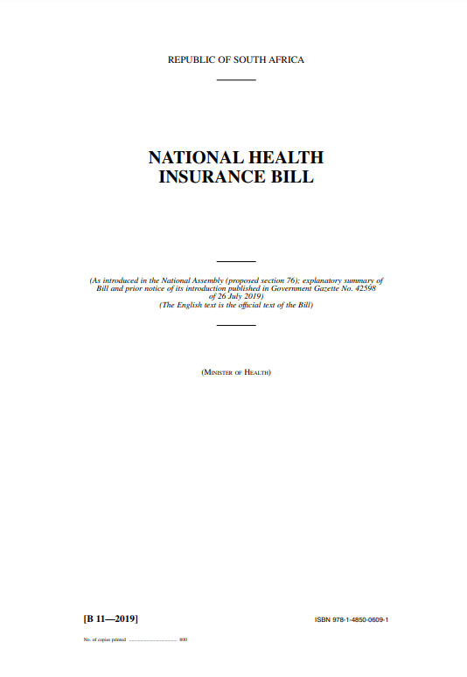
NHI FRAMEWORK | DH remains in full support of achieving universal health coverage TO ADDRESS inequities and strengthen the health system in SA
On Wednesday 24 May, amended NHI bill was approved by the Parliamentary Portfolio Committee despite the outstanding legal issues
Clause 33 states:
“Once National Health Insurance has been fully implemented as determined by the Minister through regulation in the Gazette, medical schemes may only offer complementary cover for services not reimbursable by the fund.”
Key challenges & risks:
Disregards the extensive and material input from private healthcare providers, hospital groups, medical schemes and labor unions (only minor, cosmetic changes made)
Funding of the NHI remains unclear; input from National treasury and Money Bill not disclosed
Full implementation likely to take at least a decade; presents lengthy period of uncertainty which may result in further loss of healthcare professionals
Discovery continues to advocate for a feasible NHI framework on a multi-fund basis to allow for faster expansion with lower fiscal risk. Collaboration between public & private sectors is critical to develop a workable NHI framework
Estimated Time Frame: 1-2 yrs
Estimated Time Frame: +10 yrs
AMENDED BILL APPROVED BY PPC
Bill reviewed and passed by National Assembly
Bill reviewed and passed by National Council of Provinces
Updates reviewed by National Assembly
Bill signed by President
Bill passed into Law
NHI fully implemented

