Slide 1
Importance of Primary Healthcare
DR NOLUTHANDO NEMATSWERANI | CHIEF CLINICAL OFFICER

Slide 2
Levels of Health Care
Fewer
patients seen
More specialised,
more costly
More focused on
curative services
Tertiary
Secondary
Primary
More
patients seen
More generalised
less costly
More focused on
prevention and
health promotion
https://bettercare.co.za/public-health/03-08.html

Slide 3

DEFINING PRIMARY HEALTHCARE
Primary Health Care is a whole-of-society approach to health
that aims at ensuring the highest possible level of health and
well-being and their equitable distribution by focusing on people’s needs and as early as possible along the continuum from health promotion and disease prevention to treatment, rehabilitation
and palliative care, and as close as feasible to people’s
everyday environment.
(WHO and UNICEF)
PHC is the most inclusive, equitable, cost-effective and efficient approach to enhance people’s physical and mental health,
as well as social well-being.
(WHO)

Slide 4









Components of Primary Health Care
Essential
Medication
Health
Awareness
Communicable
Diseases
Primary
Health Care
Non communicable
Diseases
Immunisation
Environmental
Health
Mother &
Child Health
Nutrition

Slide 5

The Primary Health Care Team
01
General practitioners
02
General practitioner assistants
03
Physiotherapists
04
Remedial therapists
05
Pharmacists
06
Dieticians
07
Primary Care Nurses
08
Nursing assistants
09
Primary Care Psychologists
10
Geriatric specialised practice nurses
11
Occupational therapists
12
Speech therapists

Slide 6





Importance of quality comprehensive primary care
Comprehensive primary health care delivers clinical care for the full range of high priority health issues for all people across their lifespan
It addresses the health needs of all patients at the community level, integrating care, prevention, promotion and education
Primary health care improves the performance of health systems by lowering overall health care expenditure while improving population health and access
It supports universal health coverage
It promotes positive wellbeing

Slide 7


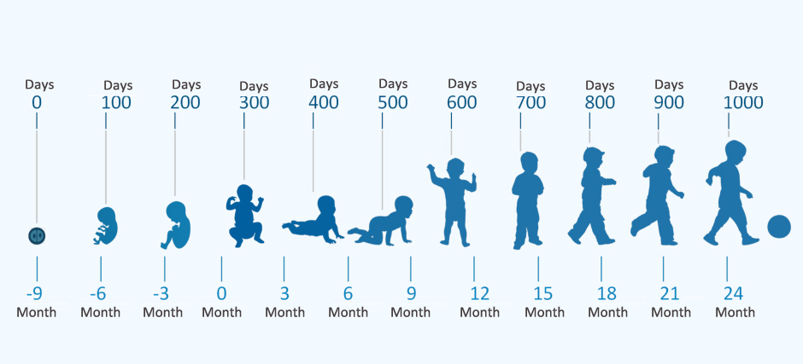
Importance of Primary Mother and child Health Care
Maternal and Child Health is designed to meet the promotive, preventive, curative, and rehabilitative needs of pregnant women before, during, and after delivery, as well as infants and preschool children from birth to five years.
It includes a focus on good nutrition, detecting and preventing diseases, ensuring access to sexual and reproductive health and supporting women who may be experiencing gender based violence.
Supports Sustainable Development Goals
Two specific global targets for maternal and child survival:
3.1: Reduce the global maternal mortality ratio to less than
70 per 100,000 live births
3.2: End preventable deaths of newborns and children
under 5 years of age
The first 1,000 days (conception to 2 years of a child’s life) are a critical period when the brain, body and immune system grows and develops significantly.

Slide 8
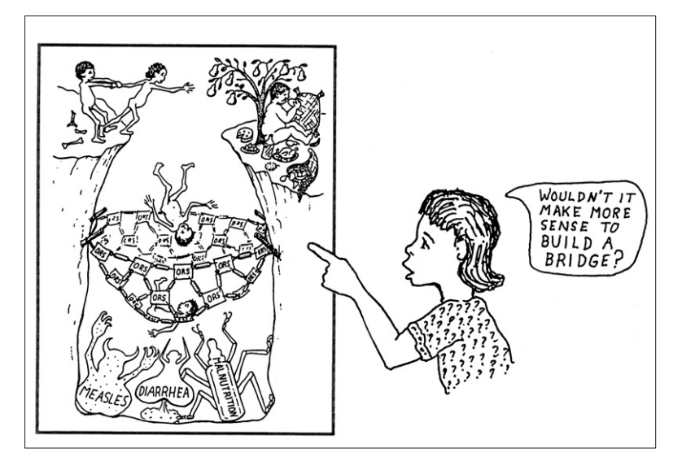
American Journal of Public Health | November 2004, Vol 94, No. 11

Slide 9


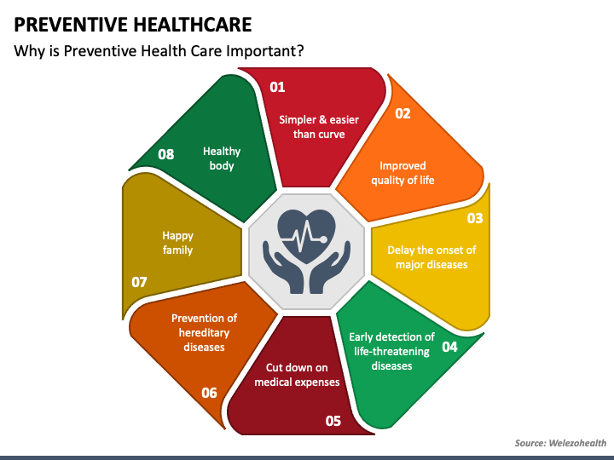

Preventative Care
Preventive care helps detect or prevent serious diseases and medical problems before they can become major,
it includes:
Childhood vaccinations, influenza vaccinations, Penumococcal vaccinations, etc
Cancer screenings: Mammograms, Pap Smears etc
Blood pressure, cholesterol, Body Mass Index, Diabetesand HIV screening
Annual check ups

Slide 10
Levels of Prevention strategy
Tertiary
Prevention
Rehabilitation,
preventing complications
and improving
quality of life
Secondary Prevention
Screening of risk individual, control of risk factors and early intervention
Primary Prevention
Health promotion and addressing risk factors,
social and generic factors
Disease
Onset
Clinical
Diagnosis
People with a health problem
Primary
Avoid development of a disease
Remove a
risk factor
Secondary
Early detection treatment
Prevent
Progression
Tertiary
Reduce complications of established disease
People at risk of a health program
Well population

Slide 11






Benefits of Cancer screenings
Advanced cancer is not only associated with poorer clinical outcomes, but also with higher healthcare costs, almost 3 times higher than the costs associated with the treatment of early disease.
CERVICAL CANCER
BREAST CANCER
COLORECTAL CANCER
Five-year survival rate for women diagnosed with advanced stage is 15%, compared to 93% if diagnosed when the cancer has not spread according to the
American Cancer Society
Late-stage breast cancer at time of diagnosis is associated with poorer five-year survival rates at 28% compared to 100% for women with localised disease
Colorectal cancer if diagnosed at an early stage before it has spread has a five-year relative survival rate of about 91%. When the cancer has spread outside of the colon or rectum, survival rates are much lower at 14%.

Slide 12

The growing burden of non-communicable diseases
Noncommunicable diseases (NCDs) kill 41 million people each year, equivalent to 74% of all deaths globally.
Cardiovascular diseases account for most NCD deaths, or 17.9 million people annually, followed by cancers
(9.3 million), chronic respiratory diseases (4.1 million), and diabetes (2.0 million including kidney disease deaths caused by diabetes)
These four groups of diseases account for over 80% of all premature NCD deaths
Tobacco use, physical inactivity, the harmful use of alcohol and unhealthy diets all increase the risk of dying from an NCD
Detection, screening and treatment of NCDs, as well as palliative care, are key components of the response to NCDs

Slide 13

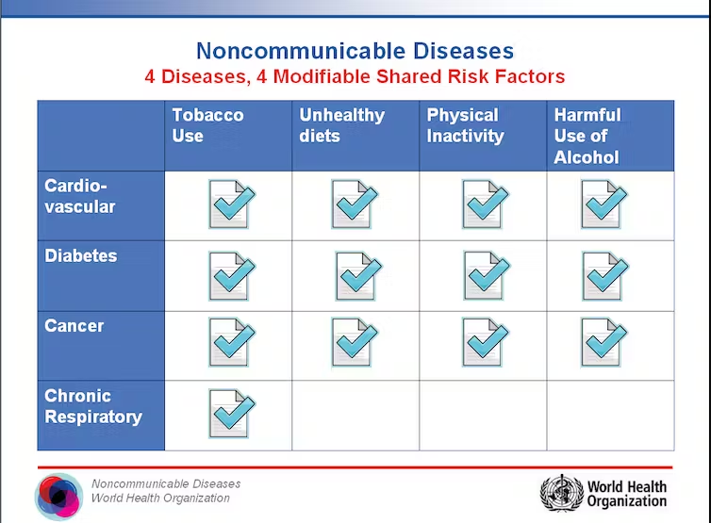
Modifiable risk factors for NCDs

Slide 14
Why is disease prevention important?
Globalisation Urbanisation Poverty Low education Stress | Tobacco us Unhealthy diet Physical inactivity | High blood glucose High blood pressure Abnormal serum lipids High waist-hip ration Abnormal lung function | Heart disease Stroke Cancer Chronic lung disease
Environmental risk factors | Behavioural risk factors | Biological risk factors | Chronic non-communicable disease
Unhealthy
behaviours
Health
risks
Chronic
disease
HEALTH CARE
COSTS
https://www.ncbi.nlm.nih.gov/pmc/articles/PMC3326808/
https://www.wellsteps.com/blog/2020/01/02/workplace-health-promotion-programs

Slide 15
Health promotion
Health promotion is the process of enabling people to increase control over, and to improve, their health
CONCEPTUAL APPROACHES AND STRATEGIES FOR HEALTH POMOTION
HEALTHY
POPULATION
POPULATION WITH
RISK FACTORS
POPULATION
WITH SYMPTOMS
POPULATION WITH KNOWN DISORDER
Promote healthy lifestyle
Prevent risk factors
(Primordial prevention)
Prevention of disorder and health problems
Health promotion and screening
Action on risk factors
Build resilience
Maintain healthy lifestyle
Early detection
Treatment and care
Maintain healthy lifestyle
Disability limitation and rehabilitation
Treatment and care
Maintain healthy lifestyle
Disability limitation and rehabilitation

Slide 16


The importance of Health Awareness
Health information is essential for maintaining good health,
preventing diseases as well as making sound health decisions.
People can only be able to access, utilise, and benefit from
healthcare services if they have proper information about these services.
Information related to every aspect of health is easily available today,
but the main problem here lies in finding, selecting, and using relevant
health information and preventing misinformation.

Slide 17
Towards a high performing Primary Care System
10
Building Blocks for High Performing Primary Care
10
Quality general
practice of the future
8
Prompt access to care
9
Comprehensive care
and co-ordination
5
Patient-team partnership
6
Population management
7
Continuity of care
1
Engaged leadership
2
Data driven improvement
3
Patient registration
4
Team-based care
https://www.agpal.com.au/about-agpal/

