Slide 1
Healthcare supply
Dr Ron Whelan, Chief Commercial Officer, Discovery Health
July 2023

Slide 2
South African healthcare overview
Primary and secondary care
Discovery Health experience

Slide 3
South African healthcare overview
Primary and secondary care
Discovery Health experience

Slide 4
South Africa population access to health insurance
ESTIMATED
Civil servants and their dependants
(incl. SoEs)
Formal Sector employed and their dependents (large business)
Formal Sector employed and their dependants (SMMEs)
Informal sector and their dependents
Individuals in households with no income or are not employed
~6m
~12m
6m
~11m
~25m
9m medical scheme members
~9m employed but not medical scheme members
~17m employed in SMME sector or informal sector
~25m unemployed
26m working or employed but not medical scheme members
Source: Discovery Health Analysis; South Africa National Department of Health

Slide 5






Overview of the South African healthcare sector and regulators
NOT EXHAUSTIVE
Providers
Payors
Government
Medical suppliers
Doctors etc.
Medical schemes
Health insurers
Parliament
Pharmaceuticals
Nurses
Administrators
Gap cover
Medical devices
Budget allocation
Managed care
organisations
Primary health plans
Consumables
Hospital cash plan
National DoH
Provincial legislature
Pharmacists
Brokers
CMS exempted
Provincial Treasury
Employer
Healthcare facilities
Individual
Provincial DoH
Road Accident Fund
Population health
programmes; conditional grants
Emergency services
Provincial hospitals
& clinics
Compensation Fund
Source: HMI provisional findings report, 2018

Slide 6
South Africa has an estimated ~400k healthcare workers, with nurses accounting for 69% of the workforce capacity
Total number of healthcare workers in South Africa
‘000
Nurses per 1000 population
415
Switzerland
54
Australia
7
5
9
16
5
Germany
Canada
United
Kingdom
286
Italy
Spain
China
23
10
Brazil
General
practitioners
Medical
specialists
Total
nurses
Pharmacists
Dentists
Physio-
therapists
Occupational
therapists
Psycho-
logists
Community
health
workers
Total
South
Africa
Source: Percept report for BUSA HRH, 2019

Slide 7
According to the World Health Organisation, 16% reduction in nurses per 1,000 population in SA between 2018 - 2020
SA doctors and nurses
Per 1000 people
Doctor and nursing training overview
13 yrs
7 yrs
1,31
-16%
Medical sub-specialist
1,10
Medical specialist
4 yrs
Registrarship
2 yrs
Specialist nurse
1 yr
Community service
Professional nurse
2 yrs
Internship
1 yrs
Community service
6 yrs
Medical school
4 yrs
Nursing school
Doctors per 1000
Nurses per 1000
Source: www.who.int

Slide 8


SA public healthcare sector is organised into national, provincial and local municipal structures, each fulfilling different role
ESTIMATED
Public healthcare delivery structure
‘000
Public healthcare workers (2019)
‘000
Total employed
Total vacant
Example
Service description
Total
nurses
110,1
13,9
124,1
11%
Ensures adherence to health policies for equitable health system
Develops strategic health priorities to improve the healthcare system
Community
healthcare
workers
~%
54,2
0,0
54,2
National
General
practioners
14,9
3,5
18,3
19%
Medical
specialists
4,7
1,1
5,8
19%
Manages spend of provincial health budget
Oversees the delivery of provincial health services across district and regional hospitals
9%
Provincial
Pharmacists
4,1
0,4
4,4
Occupational
therapists
1,1
0,2
1,3
%
Promotes health and prevent diseases by taking care of environmental services
Clinical services – provision of primary healthcare services through PHC clinics
Physio-
therapists
1,2
0,1
1,4
15%
Municipal
9%
Dentists
1,0
0,1
1,1
Psychologists
0,5
0,2
0,7
29%
Total workers
192k
19k
Vacancy rate
10%
Source: Percept report for BUSA HRH, 2019

Slide 9
South African healthcare overview
South African healthcare overview
Primary and secondary care
Discovery Health experience

Slide 10
Three levels of care
Tertiary
Care
Highly specialised;
typically research and training centres
Secondary care
Specialised services. Providers include specialists e.g. cardiologists, oncologists, diagnostic pathology services, medical devices, IH medicines and consumables
Primary care
Initial point of contact within the healthcare system. Broad range of out of hospital services, including preventative care. Providers include nurses, pharmacists or general practitioners

Slide 11







Overview of main private primary care providers
NOT EXHAUSTIVE
General practitioners
Multiple independent
general practitioners
Group general practices
Intercare
Medicross
Healthwrox
NHC
Quadcare
ExpHealth
Medipark24
Primary care providers
Pharmacies
Dischem
Clicks
Medirite
Arrie Nel
Nurse led clinics
Unjani clinics
Various other smaller
players

Slide 12





Approximately 70% of private practice GPs are located in 3 provinces
NOT EXHAUSTIVE
Private practice GP per 1000 beneficiaries (2018)
General Practitioner umbrella bodies
Total private GP’s
North
West
973
Northern
Cape
236
Independent Practice
Association Forum
South African Medical
Association
Gauteng
5,004
(~130 Independent Practice Associations)
Mpumalanga
793
Western Cape
2,056
~ 14,000 GPs
Alliance of South African Independent
Practitioners Association
Eastern Cape
1,075
KwaZulu-
Natal
2,310
Cape Primary Care
QualiCare
Free
State
732
Limpopo
973
KZN Doctors Health
Coalition
Source: CMS Provider Distribution, 2020

Slide 13






Slide 14
Overview of private sector secondary and tertiary care providers
ESTIMATED
Hospital beds per 1000 (2016)
Total medical specialists (2019)
‘000
Medical specialists by discipline (2019)
9,7
Anaesthesiology
1,169
Obstetrics &
Gynaecology
Private
sector
6,1
Surgery
Orthopaedic
surgery
Opthalmology
3,7
Plastic
surgery
Public
sector
Neurosurgery
Cardiothoracic
surgery
Beds per 1000
Public sector
Private sector
Total
Paediatric
surgery
Source: Health Market Inquiry provisional report 2018; Percept report – The supply of and need for medical specialists in South Africa, 2019; datatopics.worldbank.org,

Slide 15







Overview of main specialist societies in South Africa
NOT EXHAUSTIVE
South African Society of Cardiovascular Intervention (SASCI)
CAD Care Initiative: A shared-value initiative aimed at improving the quality and cost outcomes for patients diagnosed with coronary artery disease.
South African Orthopaedic Association (SAOA)
Joint Arthroplasty Network: The aim of this initiative is to provide all members of qualifying medical schemes who require an elective primary, unilateral hip or knee joint arthroplasty, access to a high-quality programme that delivers cost-effective care and excellent clinical outcomes in an ambulatory setting.
South African Spine Society (SASS)
Spinal Care Program (SCCP): Ensure the best possible outcomes to members suffering from back pain. The initiative provides unique benefits supported by a network of spinal surgery hospitals, surgeons and allied, focusing on scheme members suffering from severe and ongoing back pain. SCCP has three distinctive components which are Quality of care, conservative care network and Discovery Spinal Surgery Network.
South African Society of Obstetricians and Gynaecologists
Obstetrics Quality Network: A shared-value initiative aimed at improving the quality and cost outcomes in obstetric care.
South African Paediatric Association (SAPA) and Paediatric Management Group (PMG)
Paediatric Governance Program: A shared-value initiative aimed at driving behavioural change and reduce clinically inappropriate hospital admissions. Only PMG members can join the Paediatric Governance Program.
Surgicom
Surgicom Governance Project: A shared-value initiative aimed to enhance the quality of care delivered to members of medical schemes we administer, with the core focus of improving patients’ clinical outcomes.
Value based care with surgical procedures eg Lap cholecystectomies

Slide 16

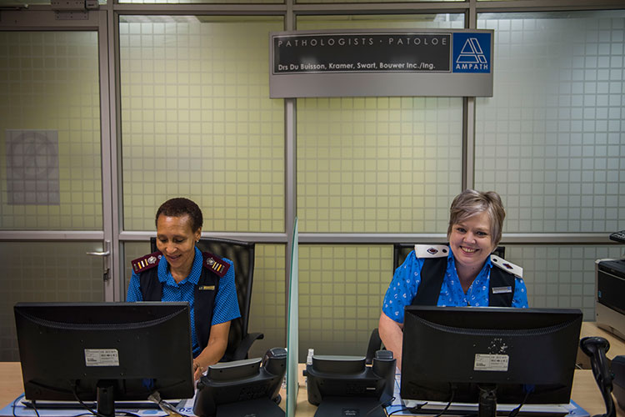


Pathology risk management

Slide 17






Pharmaceutical / medicines supply chain
Retailers
Medicine dispensing on Doctors prescription
Manufacturer
Distributor
Wholesaler
Pharmacies
Manufactures and owns the medicine dossiers
Transports from factory to wholesaler
Buys from multiple manufactures and sells to retailers
Doctors
Other dispensers
e.g., Hospitals
License required from SAHPRA
CONSUMERS

Slide 18
Main components of medicine prices
CONCEPTUAL
1
2
3
4
Medicine
supply chain
Manufacturer
Supply chain
Tax
Pharmacy
Price
components
Ex-manufacture price
Logistics fee
VAT
Dispensing fee
8 – 12%
15%
Price
R100
R8
R16
e.g., 36%, R36
R124 (incl. VAT)
SEP + Dispensing fee
Single Exit Price (SEP)
R169

Slide 19

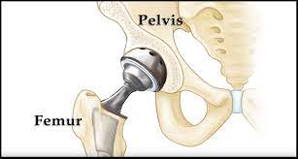
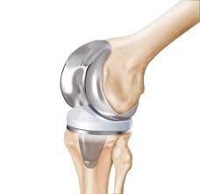
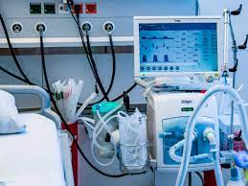

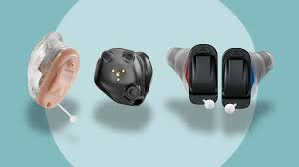
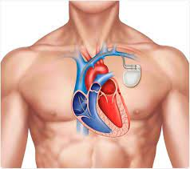
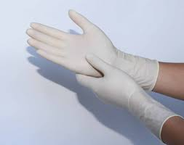
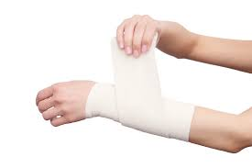
Medical devices overview
NOT EXHAUSTIVE
Surgical prosthesis
e.g., hips, knees, shoulder
Hospital devices
Medical Device defined as any instrument, appliance, material, machine, apparatus, implant, or diagnostic reagent manufactured or sold and used in the prevention, diagnosis, monitoring or treatment of illness or disease, or health purpose.
e.g., ECG’s, ventilators, IVI
Consumer devices
e.g., hearing aids, BP machine
Consumables
1
Product registration
e.g., gown, glove, bandages
2
Price benchmarking
3 Step process to
device funding at DH
3
Health Technology
Assessment

Slide 20
South African healthcare overview
Primary and secondary care
Discovery Health experience

Slide 21
Overview of Discovery Health strategic focus areas over the next 10 years
DHMS care delivery progression
2011
2023
2033
From …
… To
Acute care
Chronic care; population health management
Specialist care
Primary care
In-hospital
At-home; in-rooms; day clinics
In-person
Digital / virtual
Fee for service
Value-based care

Slide 22

















































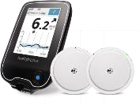




Population Dashboards
EHR
EMR
Scheduling
Population Alerts
Medicine Tracker
Alerts Nudges
Personalised
eScripts
Health Objectives
+
INTEGRATED 3rd PARTY HEALTH APPS
Care Pathways
Coaching Portal
Virtual Consults
.
self-captured
experience
Model repository
Clinical Ref Libraries
insurance
behavioral
clinical
operational
devices
Knowledge Repositories
MaaS
Models as a Service
Clinical Ontology
Groupers
Profiling & Segmentation

Slide 23
THANK YOU

