Slide 1
Introduction to the HEALTHCARE FUNDING ENVIRONMENT
DEON KOTZÉ | CHIEF PRODUCT OFFICER

Slide 2

1
WHY
do we need healthcare funding in
South Africa?

Slide 3

Healthcare is unaffordable for individuals
10 of the highest member claims paid in 2022
R6.4m
Age 51 Long-term use of a ventilator (infections)
R 5.6m
284 years
Age 45 Infection of the nervous system
worth of contributions to fund the highest claim
R 5.2m
Age 36 Long-term use of a ventilator (toxic effects)
R 4.7m
Age 0 Major surgical procedure in newborn baby
R 4.5m
Age 38 Pneumonia or whooping cough
7,055
R 4.5m
Age 32 Surgical procedures on the lungs or air passages
Individuals claimed over R500,000
R 4.2m
Age 0 Major surgical procedure in newborn baby
R 4.0m
Age 49 Heart surgery
1,867
R 3.9m
Age 62 Surgical procedures for infectious or parasitic diseases
R 3.7m
Individuals claimed over R1 million
Age 42 Surgical procedures for multiple major injuries

Slide 4
HEALTHCARE IS UNAFFORDABLE FOR INDIVIDUALS
NATIONAL HEALTH SYSTEM
POOLING OF RESOURCES OR SELF-FUNDED
Funding limited to Government resources
Government sets level of remuneration
Cross-subsidies between healthy and sick
Requires administration, co-ordination advice and education
Critical care affordable for less than 1% of the current private healthcare population
ADEQUATE FUNDING IS ESSENTIAL TO AVOID THE COST OF LIFE-CHANGING MEDICAL EVENTS WHEN IT CAN LEAST BE AFFORDED

Slide 5


Healthier members pay for sicker members
COMMUNITY RATING RELIES ON CROSS-SUBSIDIES
30% are sick
Pay 40% of premiums
Claims more than premiums
Claim 80% of benefits
Healthy members pay for sick members’ claims
70% are healthy
Claim 20% of benefits
Premiums more than claims
Pay 60% of premiums
CONSTANT CHALLENGE TO “ENTICE” HEALTHY TO REMAIN IN THE POOL

Slide 6
2
HOW
is healthcare funded in
South Africa?

Slide 7
Overview of healthcare in SA
PUBLIC SECTOR
PRIVATE SECTOR
Population
50 million
9 million
Total spend
R228bn
R197bn
% of GDP
3.8%
4.4%
Per Capita Spend
R4 560 per capita
R21 888 per capita
Funding model
Post tax contributions –
Employer and employees
Tax funded
FULLY COMPREHENSIVE PRIVATE HEALTHCARE SYSTEM OPERATING IN PARALLEL TO PUBLIC SYSTEM
Source: *World Bank (2017 – latest published)

Slide 8
Wide range of private healthcare funding solutions available to all south africans
Affordable
Comprehensive
prepaid HEALTH
MEDICAL EMERGENCY INSURANCE
HEALTH INSURANCE
MEDICAL SCHEME
Non-insurance product
Pre-purchase defined healthcare services at defined prices
Medical emergency evacuation or transport insurance product regulated through LTIA or STIA
Benefits for emergency medical treatment
Regulated by FSCA, reporting to National Treasury
Health insurance product regulated through Demarcation Exemption Framework
Benefits for primary healthcare
Regulated by the CMS, reporting to Department of Health
10 exempted insurers covering ±500,000 beneficiaries¹
Non-profit medical schemes regulated through Medical Schemes Act
PMB level of care as a minimum
Regulated by the CMS, reporting to Department of Health
17 open schemes offering 165 options covering 4.8 million beneficiaries
56 restricted schemes offering 143 options covering 4.1 million beneficiaries²
GAP COVER
Medical expense shortfall insurance, regulated through LTIA or STIA
Regulated by the FSCA, reporting to National Treasury
At least 20 insurers offering over 80 options covering ±0.6 million families³
Source: ¹ June 2022 Demarcation LCBO Update; ² CMS 2021/2022 Annual Report & Annexures; ³ GTC Gap cover survey 2018 https://gtc.co.za/gtc-healthcare-consulting-launches-inaugural-gap-cover-survey-2018/

Slide 9






MEDICAL SCHEMES ARE EFFECTIVE RISK POOLING VEHICLES
SETS HEALTHCARE POLICY
REGULATOR OF MEDICAL SCHEMES
FUNDING MECHANISM
NOT FOR PROFIT ORGANISATION GOVERNED BY BOARD OF TRUSTEES
Department
of Health
(DOH)
Council for Medical Schemes
(CMS)
Board of Trustees
Premiums
Members & employers
Medical
Schemes
(DHMS)
Benefits
Medical services
Claims
Doctors &
hospitals
Reimbursement
Administration fees
Administration & managed care services
Medical Scheme Administrator / Managed Care Organisation (DH)

Slide 10

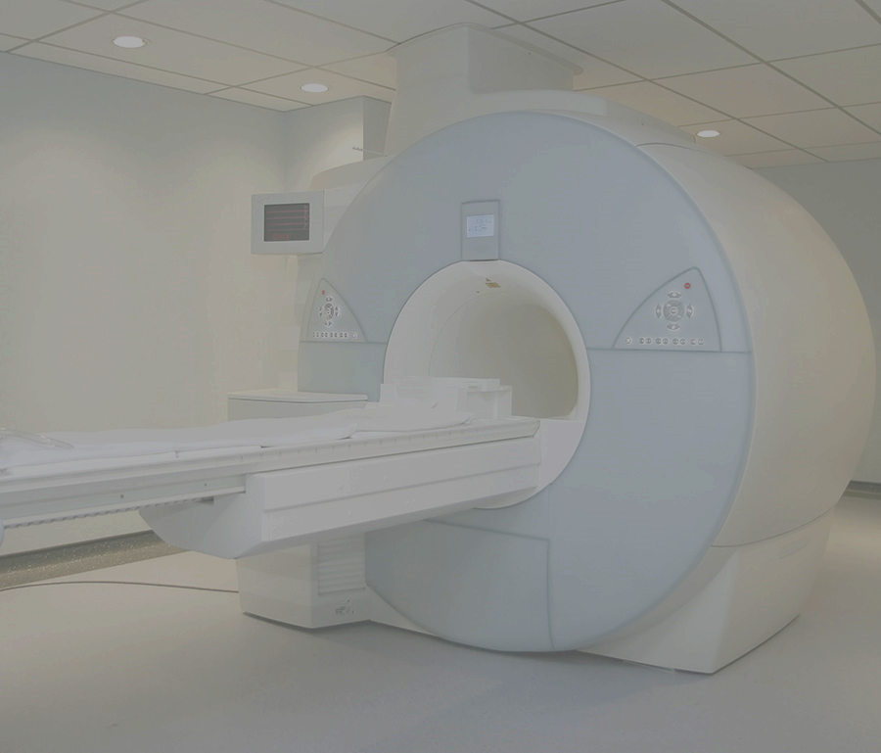



GAP COVER OFFERS REGULATED INSURANCE FOR MEDICAL EXPENSE SHORTFALS
Amount claimed
Amount paid
Cover ratio
92%
%
85%
86%
Pre-admission
Post-discharge
Admission

Slide 11



primary healthcare is highly valued by INDIVIDUALS
LOW INCOME HOUSEHOLDS USE PRIMARY HEALTHCARE CHANNELS WHEN SEEKING CARE
HOUSEHOLDS EXPERIENCE SUBSTANTIAL CHALLENGES WHEN ACCESSING CARE
HOUSEHOLDS REGULARLY USE THEIR HEALTHCARE BUDGET ON PRIMARY HEALTHCARE
~80%
of low income earners seek primary healthcare within the first 48 hours of experiencing any symptoms¹
Employees access care through public clinics and self-funded private facilities*
~97%
of healthcare budget spent on medication and private doctor consultations
~65%
Public clinics
~21%
Private doctors
Queues
70%
Self-fund care no medical aid or employer subsidies²
Transport
<24 hours
48 hours
Regular activities stopped
Many activities stopped
Last resort
Quality of care
Research shows preference to self-medicate to avoid access and affordability constraints*
Time to Seeking Care
¹M4JAM Discovery Research – September 2020
²2020 General Household Survey

Slide 12
Health insurance is effective in increasing ACCESS TO PRIMARY healthcare
Proportion on medical scheme or health insurance
Discovery membership, %
Proportion of employees on medical scheme
Monthly income, Rands
Source: Discovery Employer data 2020

Slide 13







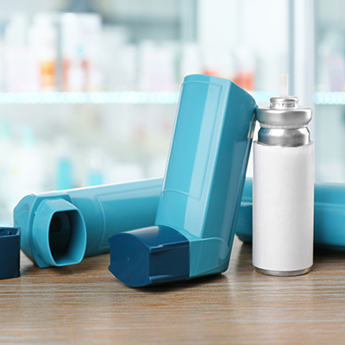
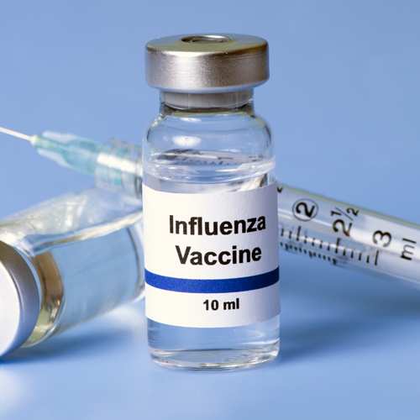


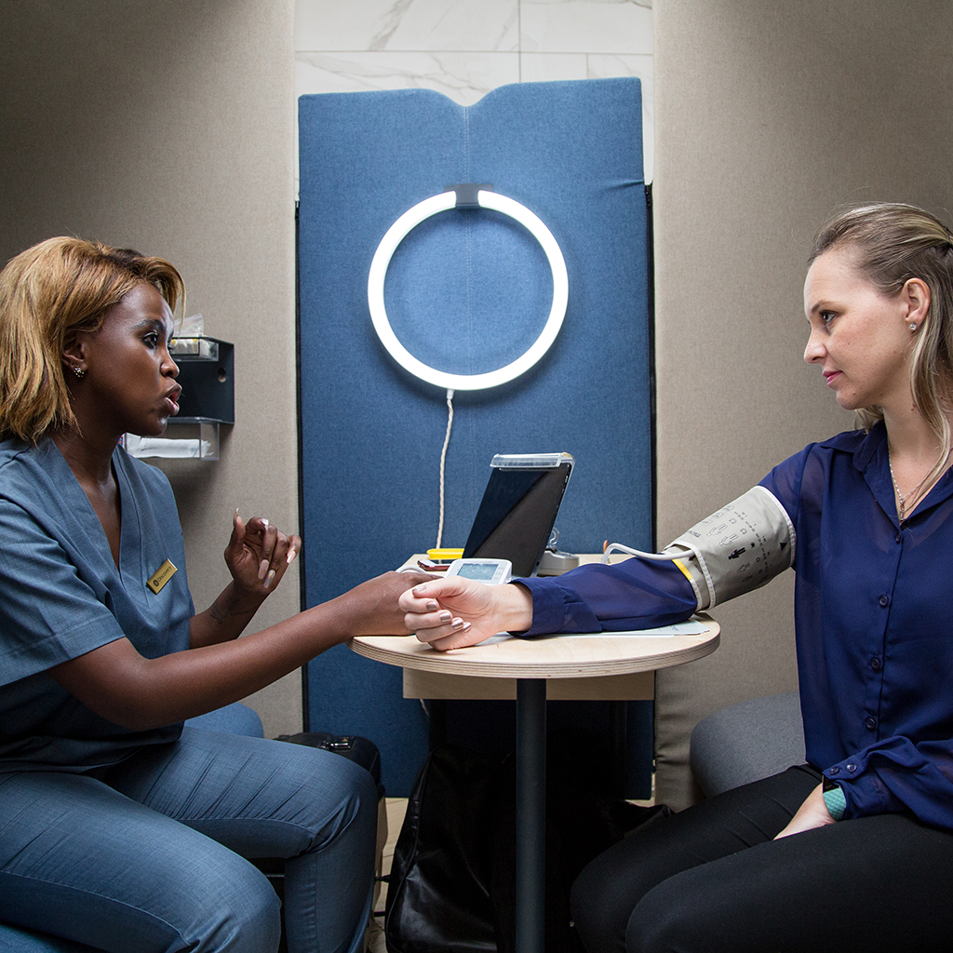

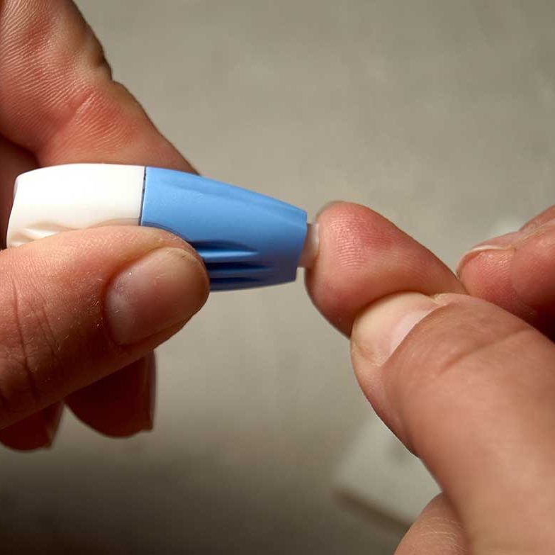


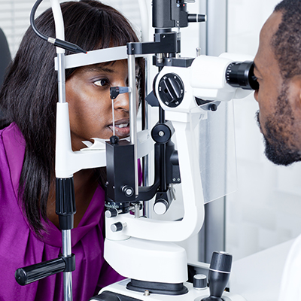

HEALTH INSURANCE BENEFITS COVER ACCESS TO PRIMARY HEALTHCARE SERVICES FOR LESS THAN THE COST OF MEDICAL SCHEME MEMBERSHIP
PRIMARY HEALTHCARE
2
4
Self medication
3
Medication
1
Over-the-counter medicine
Prescribed medicine
Chronic medicine
Maternity
HIV management
Self medication
Screening and prevention
Network GP consultations
Basic Dentistry
COVID-19 testing
Basic pathology and radiology
Maternity
HIV Care
Basic optometry
Flu vaccine
Wellness screening
5
Procedural treatment
Medical procedures done in GPs rooms

Slide 14


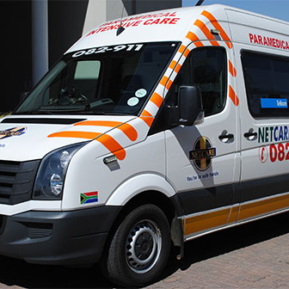
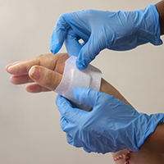
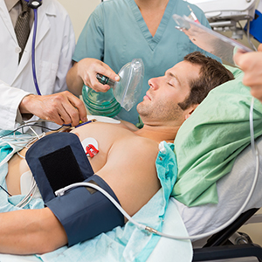

MEDICAL EMERGENCY INSURANCE PROVIDES AFFORDABLE BENEFITS FOR EMERGENCY MEDICAL TREATMENT
ACCIDENT AND EMERGENCY CARE
Ambulance services
Casualty treatment
Trauma treatment
Take-home Medication
Private ambulance transport and evacuation
Stabilisation in casualty
In-hospital treatment up to specified limits
Covered on discharge from hospital

Slide 15

INSIGHTS INTO PAY-AS-YOU-GO USE OF HEALTHCARE in South africa
RESEARCH INSIGHTS ABOUT PRIMARY HEALTHCARE FUNDING BY UNINSURED HOUSEHOLDS
RESEARCH INSIGHT 1
RESEARCH INSIGHT 2
RESEARCH INSIGHT 3
RESEARCH INSIGHT 4
ACCESS:
PRIORITISATION OF HEALTHCARE SERVICES:
AFFORDABILITY:
ABILITY TO SHARE CARE WITH FAMILY:
50% of South Africans access private healthcare on a pay-as-you-go basis
Access to medicine and a GP or qualified nurse are a key priority when ill
The current average cost of a GP consultation paid in cash is R442, excluding medicine
Cash consultations are often funded by a family member or employer
Source: Discovery Research – September 2020

Slide 16
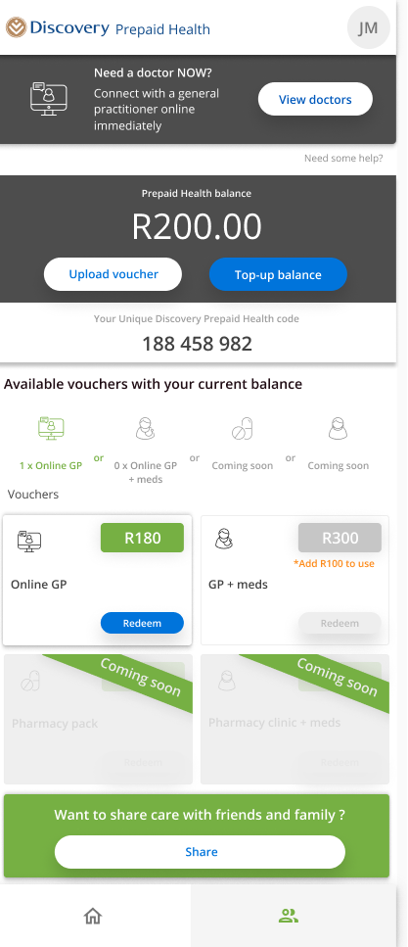






PREPAID HEALTHCARE REDUCES THE COST OF PAY-AS-YOU-GO COSTS OF PRIVATE PRIMARY HEALTHCARE SERVICE
2
Top up healthcare balance
Multiple top-up options
In-store vouchers
In-app debit or credit card
View prepaid healthcare balance
1
Discovery Bank
Discovery Miles
Affordable health services
3
Starts at R50
Retail outlets throughout South Africa
Virtual GP
In-person GP
4
Find a contracted healthcare provider
Seamless
share care functionality
5

Slide 17
Introduction to the HEALTHCARE FUNDING ENVIRONMENT
DEON KOTZÉ | CHIEF PRODUCT OFFICER

