Slide 1
OVERVIEW OF HEALTHCARE Systems
Roseanne Harris| HEAD: POLICY AND REGULATORY AFFAIRS AT DISCOVERY HEALTH

Slide 2





What is universal health coverage
WHO
Half of the world’s population does not have access to the health care they need
Universal health coverage means that all people have
access to the health services they need, when and where they need them, without financial hardship. It includes the full range of essential health services, from health promotion to prevention, treatment, rehabilitation, and palliative care
UHC does not mean free access to every possible health service for every person. Every country has a different path to achieving UHC and deciding what to cover based on the needs of their people and the resources at hand.
100 million people are driven into poverty each year through
out of pocket health spending
Over 930 million people spend at least 10% of their household income on health care
75% of national health policies strategies and plans are about moving to UHC

Slide 3



SA POPULATION BY HEALTH COVERAGE AND EMPLOYMENT STATUS
Opportunity to immediately alleviate pressure on the public sector
Unemployed lives
are dependent on
tax-funded public sector
or paying out of pocket
for private care
Employed uninsured sector is around 19m lives
who are paying out of pocket or dependent on the public sector
APPROXIMATELY 40% OF SA HOUSEHOLDS ARE USING THE PRIVATE HEALTH SECTOR (GHS)
Source: QLFS

Slide 4


The complex health financing landscape in South Africa
South Africa is often simplistically characterised as having a two-tier system
(public and private) but these are not independent nor are individuals
necessarily only seeking care in one or the other.
All are entitled to access public sector facilities on a means-tested basis.
Many lower income earners are paying out of pocket for some private sector care
as they cannot afford medical scheme cover which is subject to legislated
prescribed minimum benefits which sets a floor price for cover.
Over 87% of national health budget allocated to provinces
16% of the population has medical scheme cover
2017 General Household Survey (Stats SA)
  27% of households use private healthcare facilities as point of entry
  23% of households have at least one member on a medical scheme
National Income Dynamics survey (UCT, 2014)
  41% used private provider at last visit
SA enjoys high levels of catastrophic cost protection (World Bank)
And low levels of out of pocket expenditure (WHO).

Slide 5
Interpretting International comparatives
HEALTHCARE FINANCING (PPP PER CAPITA)
HEALTHCARE FINANCING (% ALLOCATION)

Slide 6







Transforming the SA Health System
  PATIENTS
  FUNDING
  PROVIDERS
Addressing inefficiencies in public and private care
Human
resource planning
Collaborative efforts to improve health system infrastructure
Information systems to enhance delivery
Outcomes monitoring
and evaluation

Slide 7
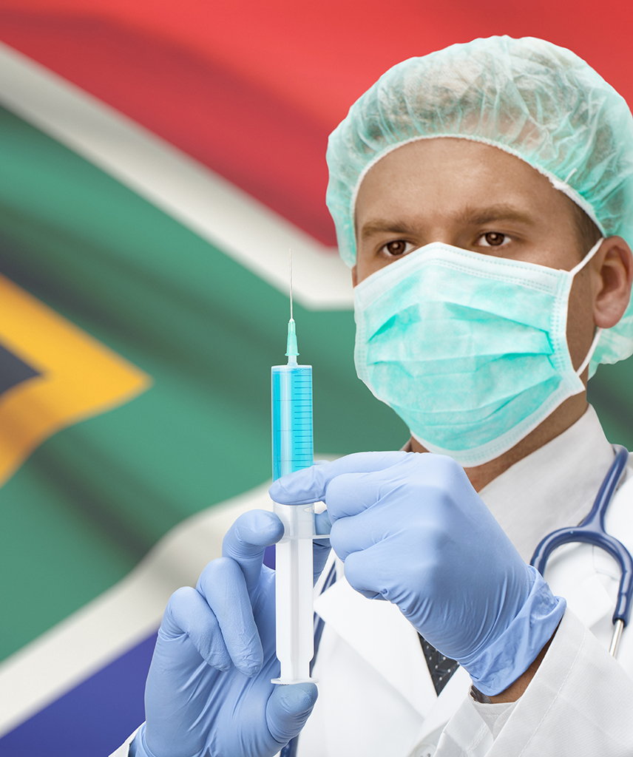
South Africa’s democratic government faces significant challenges in providing high-quality healthcare
The ‘quadruple burden’ of disease
  Maternal, newborn and child health
  HIV/AIDS and tuberculosis (TB)
  Non-communicable diseases
  Violence and injury
The racialised nature of poverty levels and unemployment rates;
Huge spatial inequalities
Inequities among provinces, urban-rural; public-private health sectors
Inadequate resources (human, financial and physical);
Poor management and governance of the health system;
Gaps in ethical leadership and lack of accountability

Slide 8

SA faces multiple macro-economic challenges
Sustainable funding for NHI requires economic growth
SA economy has been adversely affected by COVID-19 induced recession
GDP growth between 2023 to 2024 is expected to contract from 2.1% in 2022 to 1.6% and 1.7% in 2023 and 2024.
Unemployment levels are higher than before Covid
NDoH refers to increasing tax by R200bn to fund NHI
Adverse implications of increasing tax burden:
  A flat rate or payroll tax is regressive.
  A higher personal income tax burden would reduce disposable income and household consumption and savings (which may compromise investment and future economic growth).
  Despite zero-rating of basic necessities, there is an equity concern that VAT is regressive
PHASED IMPLEMENTATION IS MORE FEASIBLE AND ENCOURAGES PRIVATE SECTOR INVESTMENT AND SUPPORT FOR AN INTEGRATED MODEL FOR HEALTH DELIVERY WHICH IS MORE LIKELY TO ACHIEVE POLICY OBJECTIVES
- BUT THIS APPROACH FACES IDEOLOGICAL BARRIERS.

Slide 9

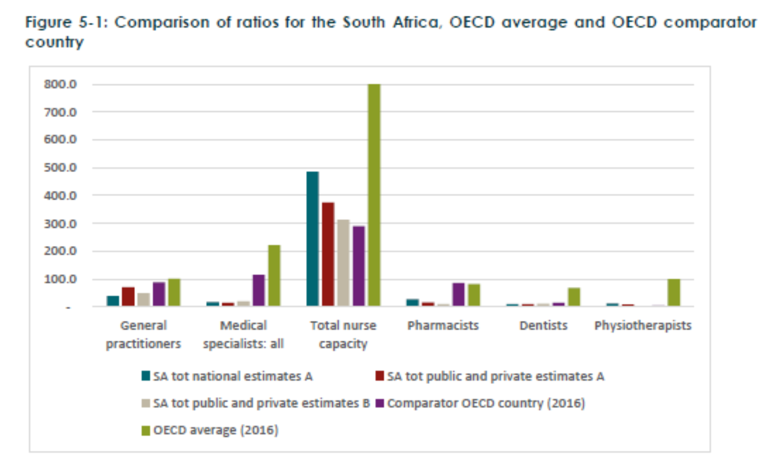
Shortage of health professionals and constrained pipeline is a fundamental challenge
The NHI Bill expects the monopsony power of the NHI Fund to persuade doctors to increase their workloads
(caring for more patients) for equivalent or lower remuneration. But…
Global challenge – migration of skills
Requires real (per capita) increases in health budget
Requires a well-planned training framework – focused on necessary skills
Requires appropriate incentives to work in NHI system
  Outcomes based remuneration
  Appropriate clinical support
    Staffing
    Equipment
    Facilities
    Guidelines
Opportunity to use technology to enhance access
Overall shortages compared to targets and comparator countries
The largest shortages affect the following disciplines: anaesthesiology, paediatrics, surgery. These are the disciplines most needed for maternal and child-care.
Cost of filling posts estimated at R10bn per annum
Limited available data – needed to combine data sources

Slide 10

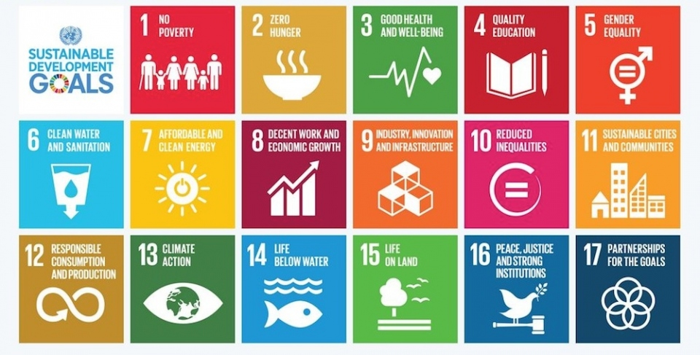
South African health system performance and progress
World Bank has assessed catastrophic health expenditure protection as being in top half of 183 countries surveyed
World class skills in terms of clinical and risk management
Out of Pocket (OOP) expenditure levels are low relative to peers
SDG Index score of 63.7 in 2021 (Ranked 108)
Improvements in SDGs over the last 15 years
  Life expectancy: increased from 52 to 65
  Infant mortality rate: decreased from 57.8 deaths per 1 000 live births to 24.1
  Maternal mortality rate: decreased from to 312 per 100 000 live births to 113
  Mother-to-child transmission of HIV: decreased from 10.9% to <1%
OPPORTUNITIES FOR COLLABORATION TO CONTINUE IMPROVING PUBLIC HEALTHCARE

Slide 11




COVID-19 revealed fundamental changes are needed to strengthen the health system in anticipation of NHI
Funding and
financing model
Capacity
Regulations
Disease Burden
Consider financing model
(NHI Bill) in light of all the related factors that make up a
health system
Sustainable funding for
health is demonstrably
enabled by an
active private sector
Enhancing state capacity is essential in order to reap the benefits of UHC
System requires a major effort at increasing the health professional capacity
(with private sector investment) during transition to NHI
Requirement for
simultaneous regulatory changes in public and private health to improve access
and lower costs, as per
the HMI Report
Improve channels for
public-private collaboration
Invest in strategies to
reduce the burden of
non-communicable disease
The NHI Fund should
consider deliberate investment in
preventative care

Slide 12








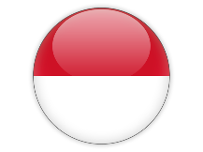
South African health system performance and progress
Parallel funding model
Dominant Public funding model
Blended funding model
Market for private health insurance alongside public insurance
May include regulation or social solidarity framework
May purchase service from public or private providers of care
Incomplete social solidarity framework in the private sector can impede access in the public sector
Single public funder model
Public or private providers of care
Smaller role for private insurers
Smaller demand for private insurance in UK and Canada due to extensive access in public sector
Large out of pocket expenditure in Ghana due to lack of access in public sector
Multi-funder model
Two or more funders
Public and private insurers
Compulsory membership elements
Employer role in funding can increase affordability
Multiple pools enable competition
Multiple pools increase ability to generate funds for cross subsidies
Description
Australia
Brazil
Germany
Canada
Ghana
UK
Netherlands
Thailand
Indonesia
Country examples
Relevance to SA
ACROSS COUNTRIES, HEALTHCARE REFORM PIVOTS OFF EXISTING INFRASTRUCTURE
NO COUNTRY HAS IMPLEMENTED A REGULATED LIMITATION ON THE SCOPE OF PRIVATE HEALTH INSURANCE COVER

Slide 13







Complexity of comparisons
 |  | Gini coefficient | Health professionals per 1000 people |  | Monthly health financing per capita relative to SA | Total healthcare expenditure to GDP
 |  |  | Nurses and midwives | Physicians
 | South Africa | 63 | 5 | 5
 | Thailand | 38 | 2 | 0.5
 | Brazil | 51 | 7 | 2
 | Chile | 48 | - | -
 | United Kingdom | 33 | 8 | 3
 | Canada | 34 | 10 | 3
 | Australia | 35 | 13 | 3
UNITED NATIONS DEVELOPMEN PROGRAMME Human Development Reports World Bank, 2014 WHO Global health expenditure database World Bank, 2016

