Slide 1
Global health trends - digital health
JULY 2023

Slide 2



Agenda
TRENDS IN DIGITAL APPLICATIONS FOR HEALTHCARE
ACCELERATING
DIGITAL HEALTH
UPTAKE
DISCOVERY HEALTH’S DIGITAL PLATFORM OFFERING

Slide 3




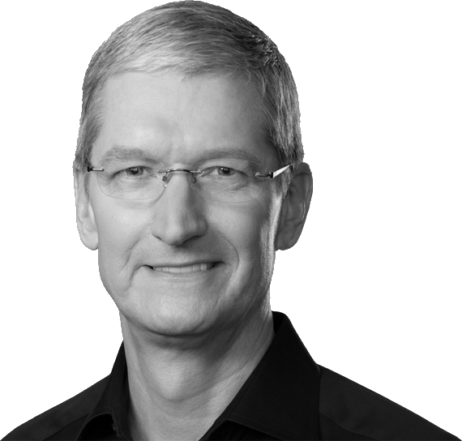


Accelerated by the pandemic, the movement towards digital health is in full force
HEALTH INSURERS CONTINUED TO ACQUIRE AND PARTNER WITH DIGITAL HEALTH PROVIDERS…
… WHILE BIG TECH CONTINUED TO
INVEST HEAVILY IN HEALTHCARE
“If you zoom out into the future, and you look back, and you ask the question:
‘What was Apple’s greatest contribution to mankind?’ it will be about health.
We're democratizing it. We're taking
what has been with the institutions and empowering the individual
to manage their health.”
United Healthcare acquired Change Healthcare
(data analytics company)
Humana acquired One homecare solutions
Centene acquired Apixio
(AI tools to extract and analyze clinical data for cost-related insights and health outcomes)
Aetna partnered with Inpathy (mental health platform)
Cigna acquired MDLive (telehealth company)
Bright Health
acquired Zipnosis
(telehealth company)
Tim Cook, Apple CEO

Slide 4





Digital capabilities available span the full healthcare pillars, from screening to treatment
Screening, diagnostics and remote monitoring: AI-symptom triage, remote monitoring and diagnostic devices for connected chronic and acute care; POC at providers; at home testing for a range of ailments
Virtual care delivery via telemedicine marketplace: telehealth capabilities, including “care team” concept and customized views for multiple different HCP profiles
Disease management and therapeutics: health education; customised condition management journeys and programmes, coaching, and digital therapeutics
Medicine management and selection: E-scripting, medicine adherence tool and medicine delivery service
Clinical intelligence and digital enablement for providers: E.H.R, population health management dashboards, and nudges for care team members to take certain actions
Administrative automation and digitization: PMA-integrated scheduling, billing and workflow automation for providers, Find-a-provider tool

Slide 5





Key current trends defining strategies in the healthcare space
01
02
03
04
05
BUILD, BUT PARTNER WHERE APPROPRIATE
EXPANSION OF REMOTE CARE SERVICES
AI TECH FOR AUTOMATION
SUSTAINED USER ENGAGEMENT
E-COMMERCE LIKE PAYMENTS
Payers are now builders of platforms, analytical engines and journeys
Partnerships for point-to-point, isolated features
Extend beyond
quick diagnosis
Latest testing services (personalised drug dosing, genomics)
Enable system-wide virtualization by integrating numerous points in journeys & workflows - move towards “Everything
at Home”
AI solutions to drive efficiency and cost gains
Application of AI expanding from care and population management to workflow / back-office automation
Sustained user engagement is becoming a primary focus for platform owners
Simple, proactive,
end-to-end journeys,
that sustainably engage members and providers
Demand for “e-commerce-like”
digital payment experiences in
healthcare with transparent pricing, automated payments processing, and efficient payment methods

Slide 6
Agenda
TRENDS IN DIGITAL APPLICATIONS FOR HEALTHCARE
ACCELERATING
DIGITAL HEALTH
UPTAKE
DISCOVERY HEALTH’S DIGITAL PLATFORM OFFERING

Slide 7
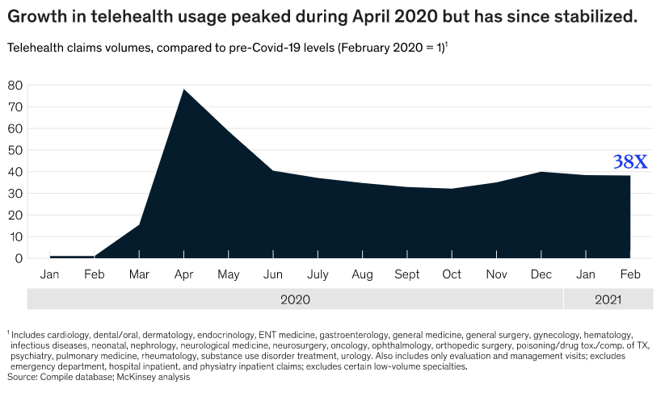



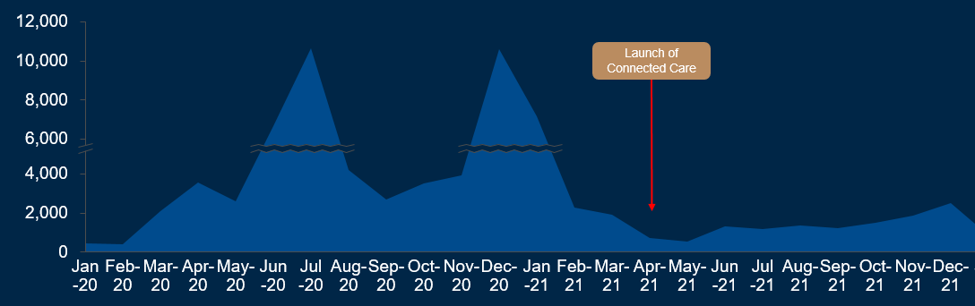
Globally, trends show significant increases in telehealth volumes since pandemic
COVID-19 IMPACT ON TELEHEALTH
Dropped barrier: regulatory
Telehealth usage in Discovery Health
Increased motivation: Doctor & Member

Slide 8







Driving uptake for digital health
Regulatory
Awareness
Simplicity
Incentives
(across all stakeholders)
Expand use cases
Access

Slide 9


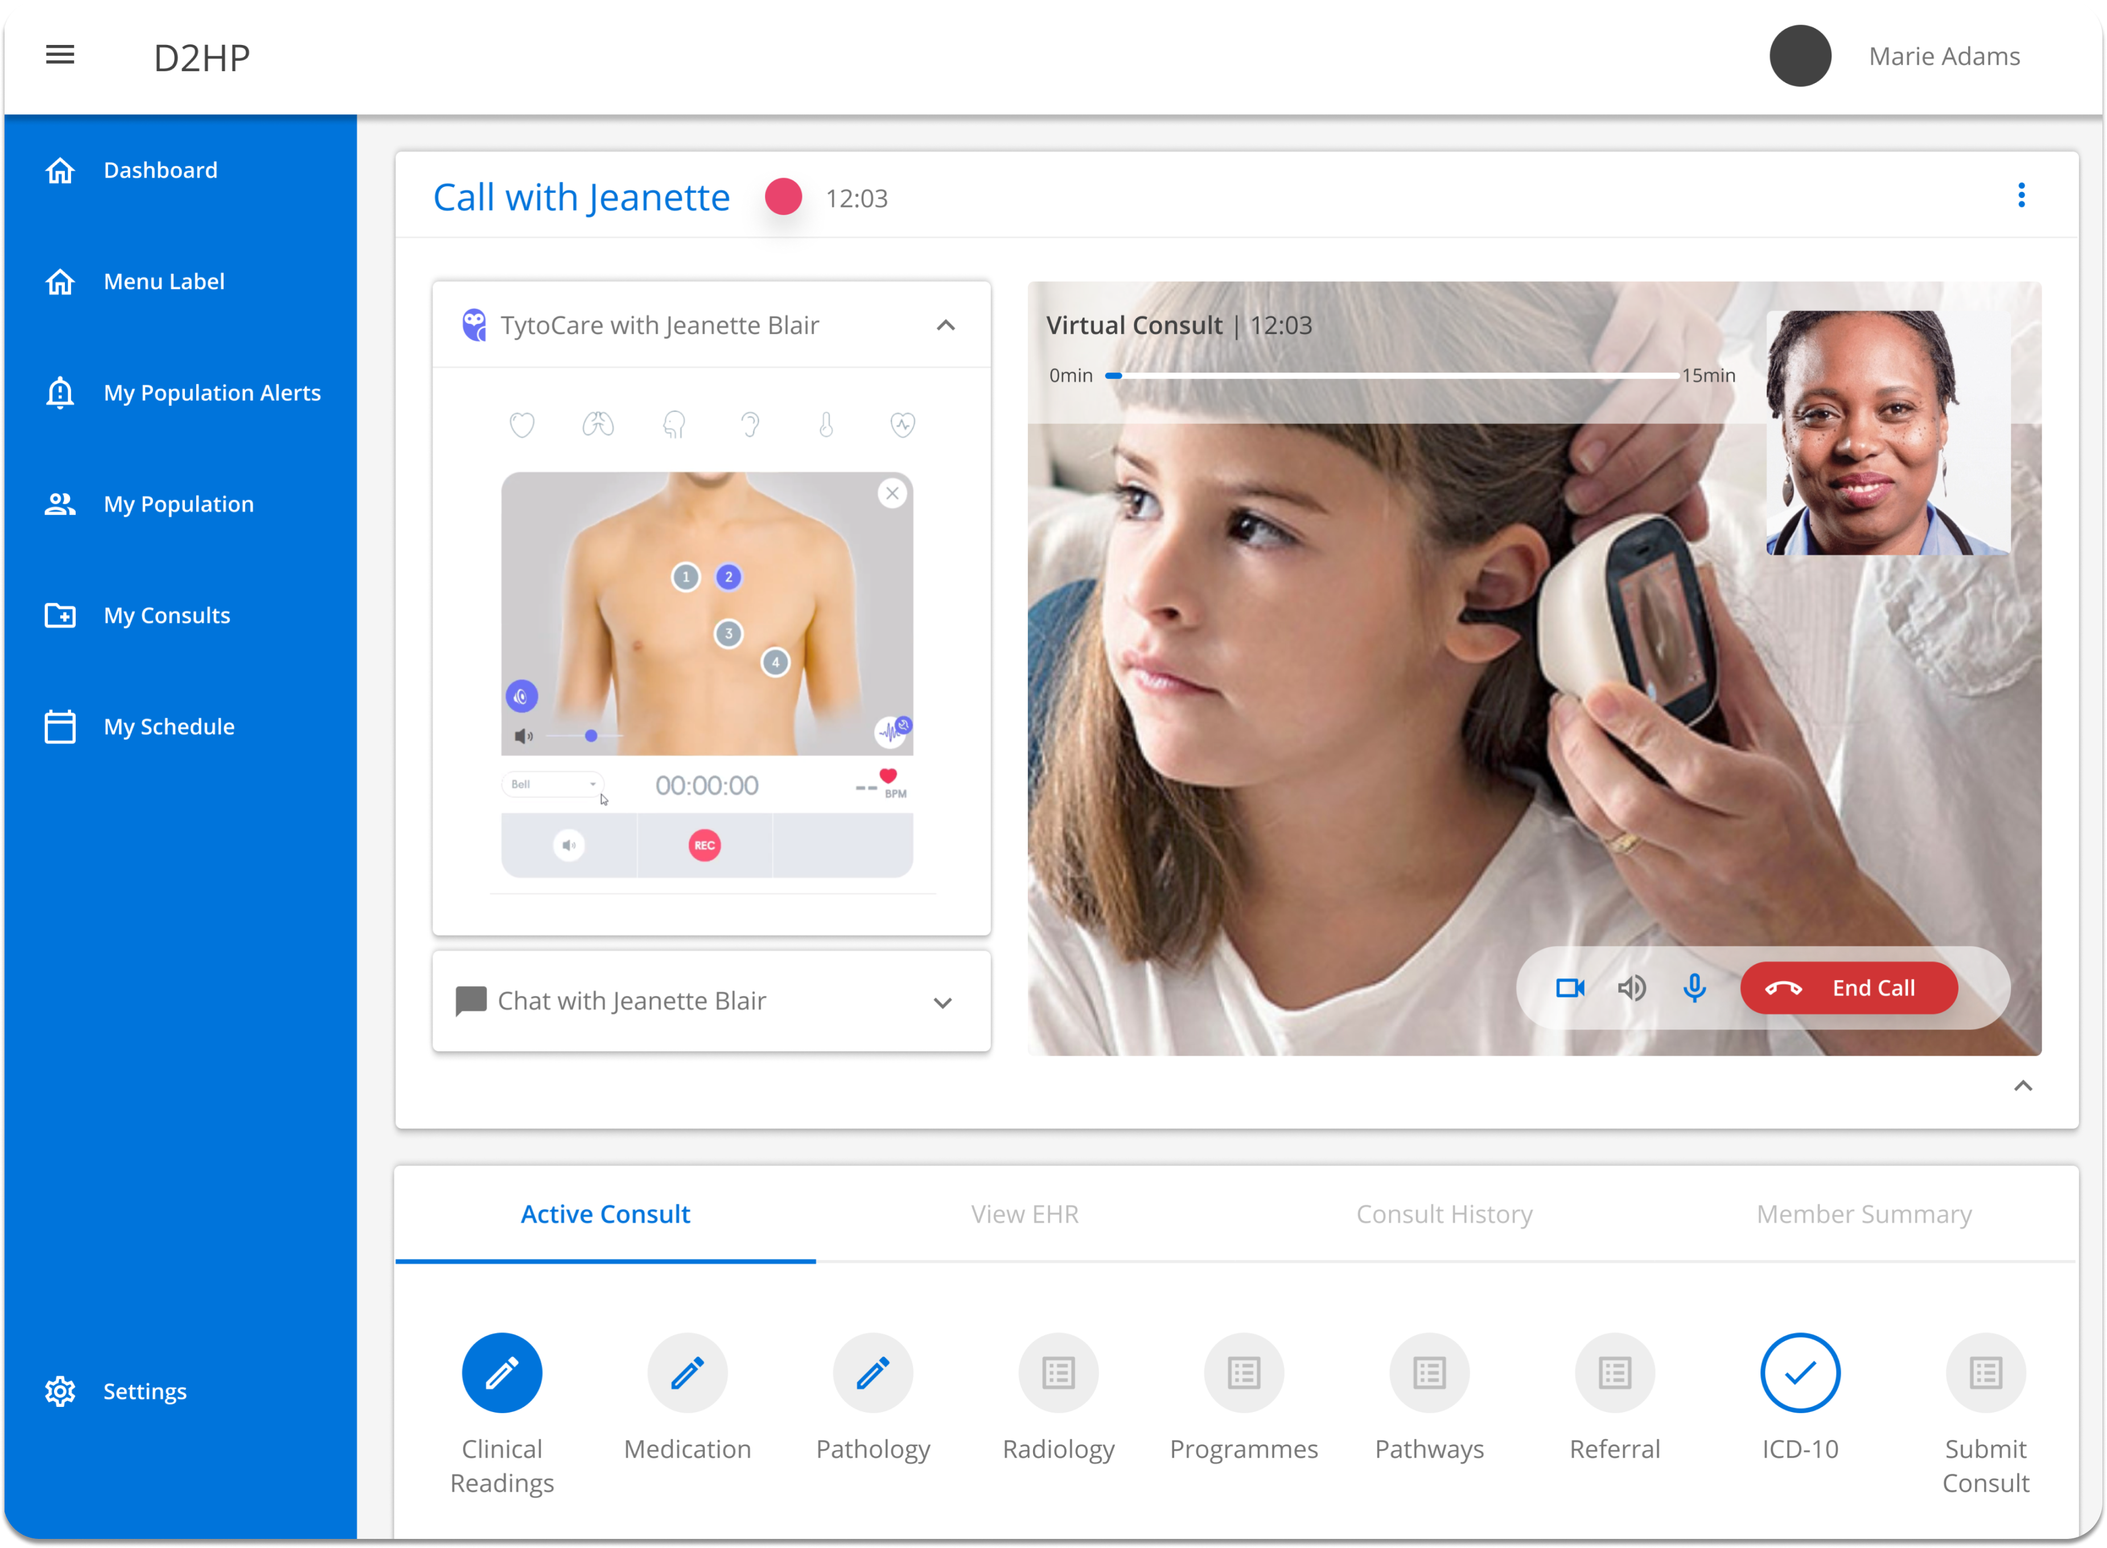
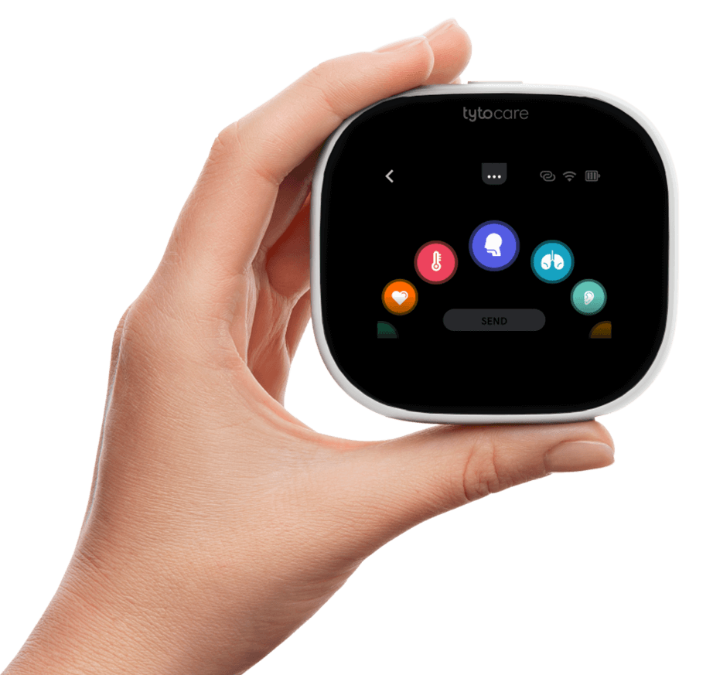
Expanding use cases and ACCESS
Example:
Tytocare
(device
manufacturer)
Click for video
Device
distributor
Device
importer
Discovery
Health
Device
rental
Core group
(iStore)
Online mall
operator

Slide 10
Agenda
TRENDS IN DIGITAL APPLICATIONS FOR HEALTHCARE
ACCELERATING
DIGITAL HEALTH
UPTAKE
DISCOVERY HEALTH’S DIGITAL PLATFORM OFFERING

Slide 11

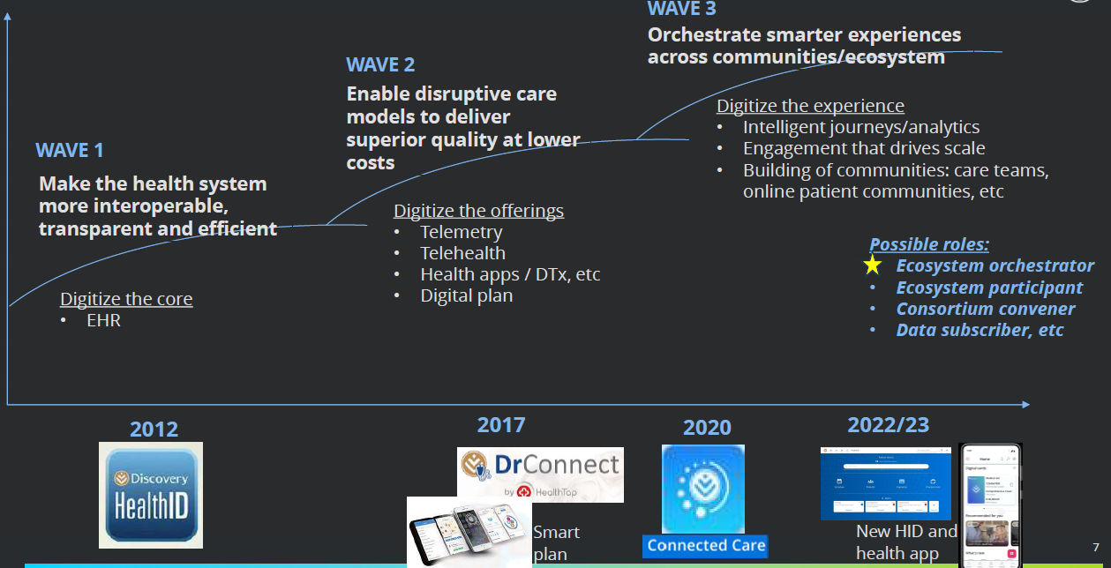
Digital health platform | journey thus far

Slide 12

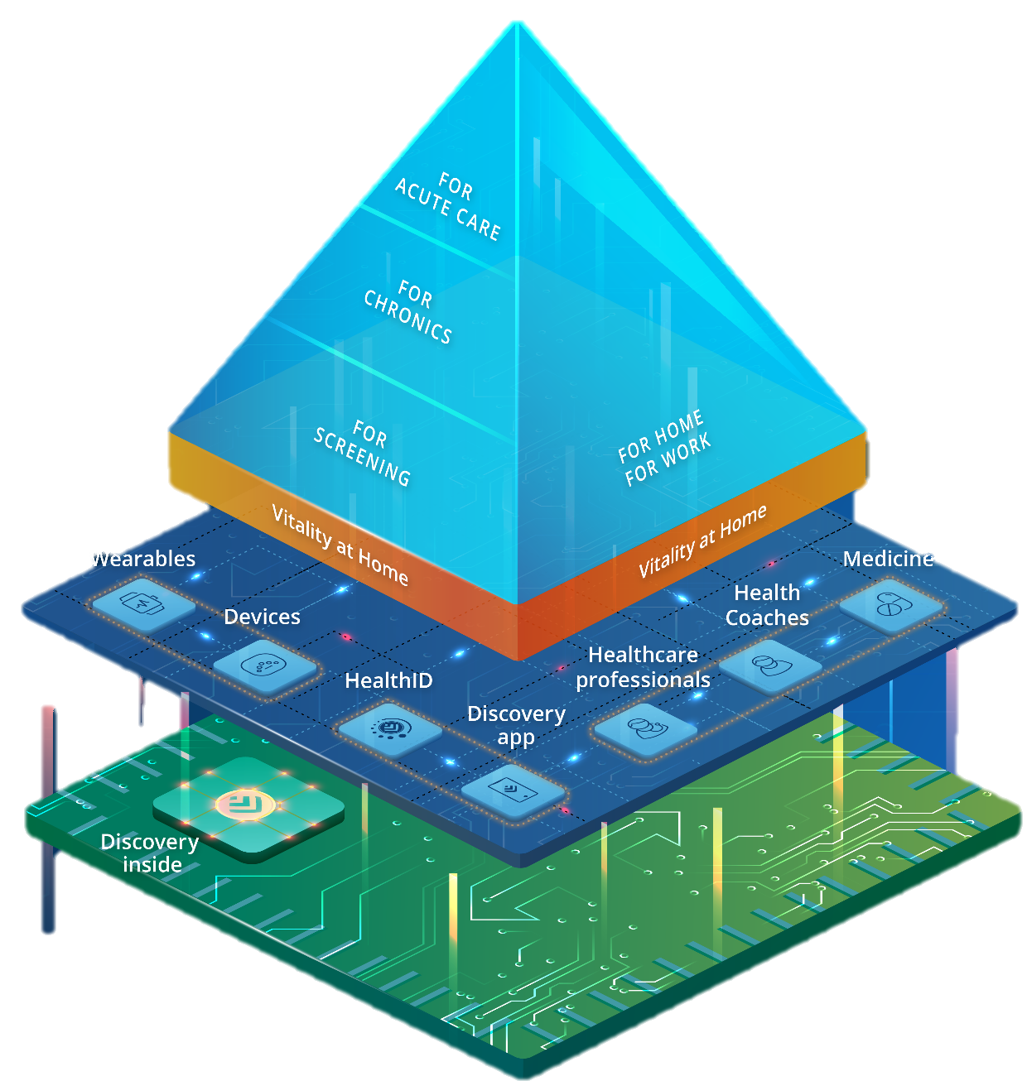




Digital health platform | orchestrate an integrated ecosystem that enables holistic digital care delivery
PROVIDER
CLIENT
3RD PARTY ECOSYSTEM
INTERACTIONS: supported by data products and journeys
ENTITY
MANAGEMENT
CONSENT
MANAGEMENT
STANDARD
INTEGRATION APIs

Slide 13
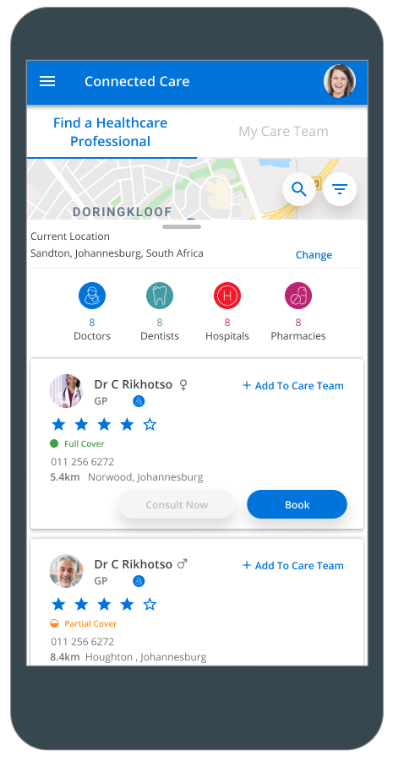
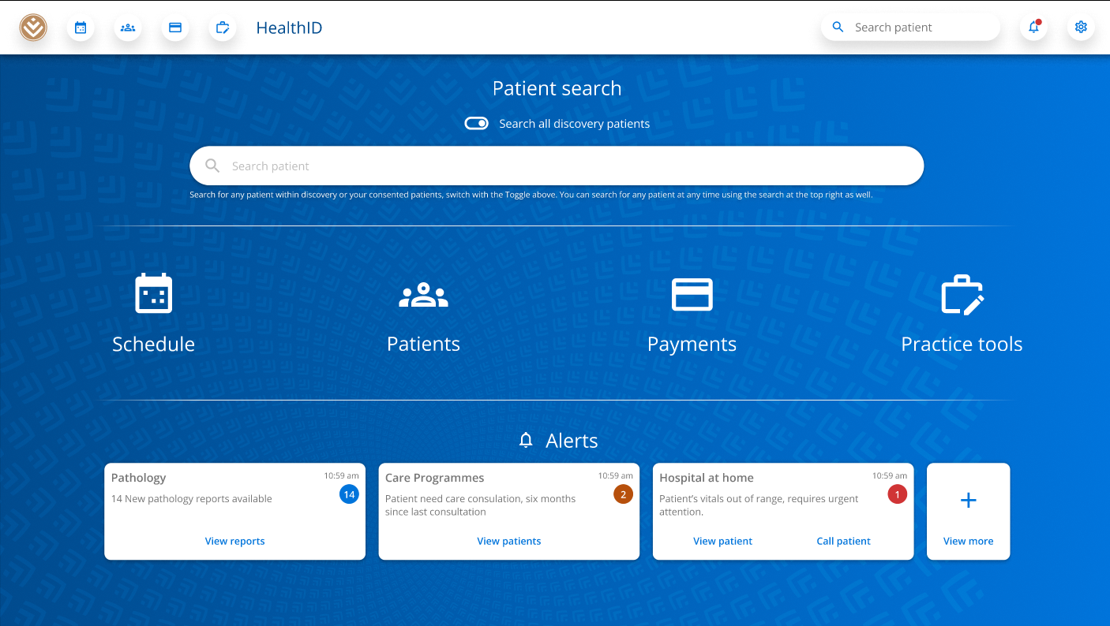
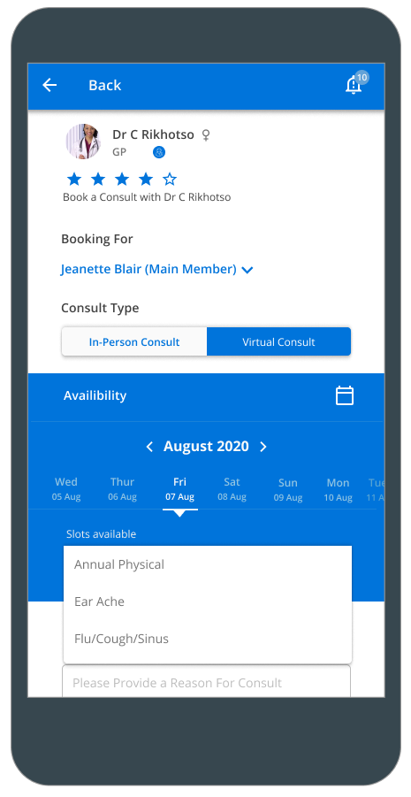
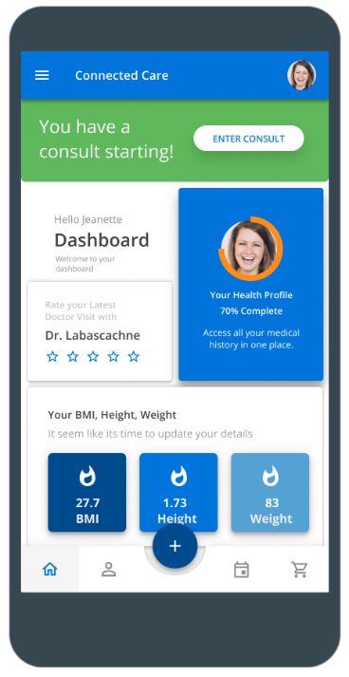
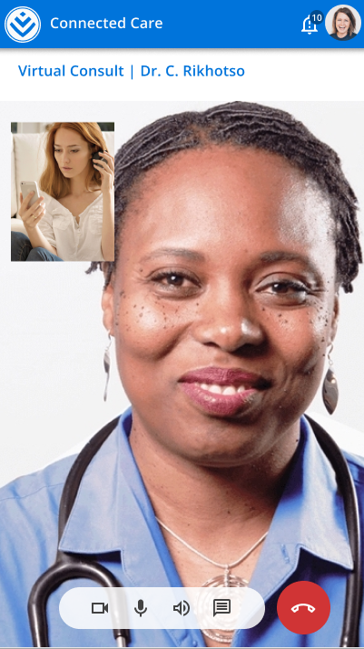
Digital interfaces
PROVIDER – HEALTHID
MEMBER – APP / WEB

Slide 14


Slide 15




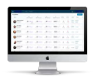
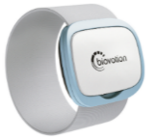
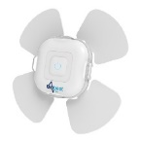
Hospital at Home
A HIGHLY SKILLED
CLINICAL TEAM
STATE OF THE ART
DEVICES & ANALYTICS
HIGH QUALITY,
SCALABLE PROGRAM
Physical and virtual 24-hour care delivery facilitated by a care team including doctors,
home care nurses and
allied healthcare professionals
Access to the latest remote monitoring devices which automatically transmit information to a hospital-based care team
AI algorithms that provide a predictive view
of a patient's disease trajectory which allows for early detection of potential issues
Offering a range of clinically appropriate services and procedures
Provide superior quality of care to support 37,000 hospital admissions per year
(expanding over time to 160,000 admissions p.a.) safely and more cost effectively

Slide 16

Hospital at Home
Source: https://www.youtube.com/watch?v=0_gAtTwTlrQ

Slide 17

QUESTIONS?
QUESTIONS
Source: https://www.youtube.com/watch?v=0_gAtTwTlrQ

