Slide 1
how do medical schemes operate
DEON KOTZÉ | CHIEF PRODUCT OFFICER

Slide 2

1
WHY
do we need
pooling of funds?

Slide 3


How much does a renal dialysis patient cost the scheme Each year?
a
R100 000
b
R300 000
c
R450 000
d
R600 000

Slide 4
How much does a renal dialysis patient cost the scheme Each year?
a
R100 000
b
R300 000
c
R450 000
d
R600 000
Represents average cost per member for members undergoing renal dialysis, and so includes the costs of other conditions that renal patients may have

Slide 5
How many years would it take to repay the costs OF renal dialysis
FOR one YEAR?
a
6
b
18
c
27
d
50

Slide 6
How many years would it take to repay the costs OF renal dialysis
FOR one YEAR?
a
6
b
18
c
27
d
50
Based on member with a Classic Saver plan, with approximately
R1 900 available from contributions to cover claims

Slide 7
How many members need to be on the scheme in that same YEAR to support one sick member?
a
35
b
42
c
46
d
50
Assume a healthy member claims R800 p.m. from the scheme
Calculation based on members on Classic Saver plans

Slide 8
How many members need to be on the scheme in that same YEAR to support one sick member?
a
35
b
42
c
46
d
50
Assume a healthy member claims R800 p.m. from the scheme
Calculation based on members on Classic Saver plans

Slide 9


Healthier members pay for sicker members
Theory of community rating
30%
are sick
Pay
40% of premiums
Claims more than premiums
Claim 80% of benefits
Healthy members pay for sick members’ claims
70%
are healthy
Claim 20% of benefits
Premiums more than claims
Pay 60% of premiums
CONSTANT CHALLENGE TO “ENTICE” HEALTHY TO REMAIN IN THE POOL

Slide 10

2
HOW
are medical schemes
governed?

Slide 11






In SA risk pooling is achieved through medical schemes
MEMBERS
POOL MEMBER FUNDS
PROVIDERS
Medical scheme
Hospitals
Doctors
CONTRIBUTIONS
CLAIMS
Specialists
Pharmacies
Medical scheme
PAY CLAIMS ACCORDING TO MEMBER BENEFITS
MEDICAL SCHEMES ARE THE ONLY LEGAL WAY TO COVER THE ACTUAL MEDICAL COSTS OF HEALTHCARE

Slide 12

The relationship between schemes and administrators
Administered by Discovery Health
Discovery Health Medical Scheme
Not-for-profit organisation
Managed care services
1
1
Administration services
2
2
Pooling vehicle for members’ funds
Part of Discovery Holdings, a listed company on JSE
Governed by board
of trustees
3
3

Slide 13




STRONG INDEPENDENT GOVERNANCE STRUCTURES WITH MAJORITY
MEMBER-ELECTED TRUSTEES
OUR GOVERNANCE STRUCTURES
TO PROMOTE DESIRED OUTCOMES
IN ACCORDANCE WITH KING IV
AN ETHICAL CULTURE
GOOD PERFORMANCE
GOVERNS
BOARD OF TRUSTEES
BELONG
TO
SUPPORTS
ELECT
APPOINTS
SERVICES
DHMS
members
BOARD COMMITTEES
REPORTS TO
MANDATES
EFFECTIVE CONTROL
LEGITIMACY
APPOINTS OUTSOURCES TO
Administration and managed care provider
REPORTS TO
PRINCIPAL OFFICER
SCHEME OFFICE
OVERSEES

Slide 14










Roles, responsibilities and fiduciary duties of Trustees
Scheme sustainability
Provision of administration and managed care services
Strategic risk management
Compliance with the Scheme Rules, the Medical Schemes Act and other legislation
BOARD OF
TRUSTEES
The Trustees are responsible for the strategic oversight and sound management
of the Scheme,
including:
Stakeholder relations
and communication
Innovation and improvement of operations
Protection of
beneficiaries’ interests
Financial and other
control systems
Benefit design and implementation
Investment strategy
and returns

Slide 15
3
HOW
do medical schemes
work?

Slide 16
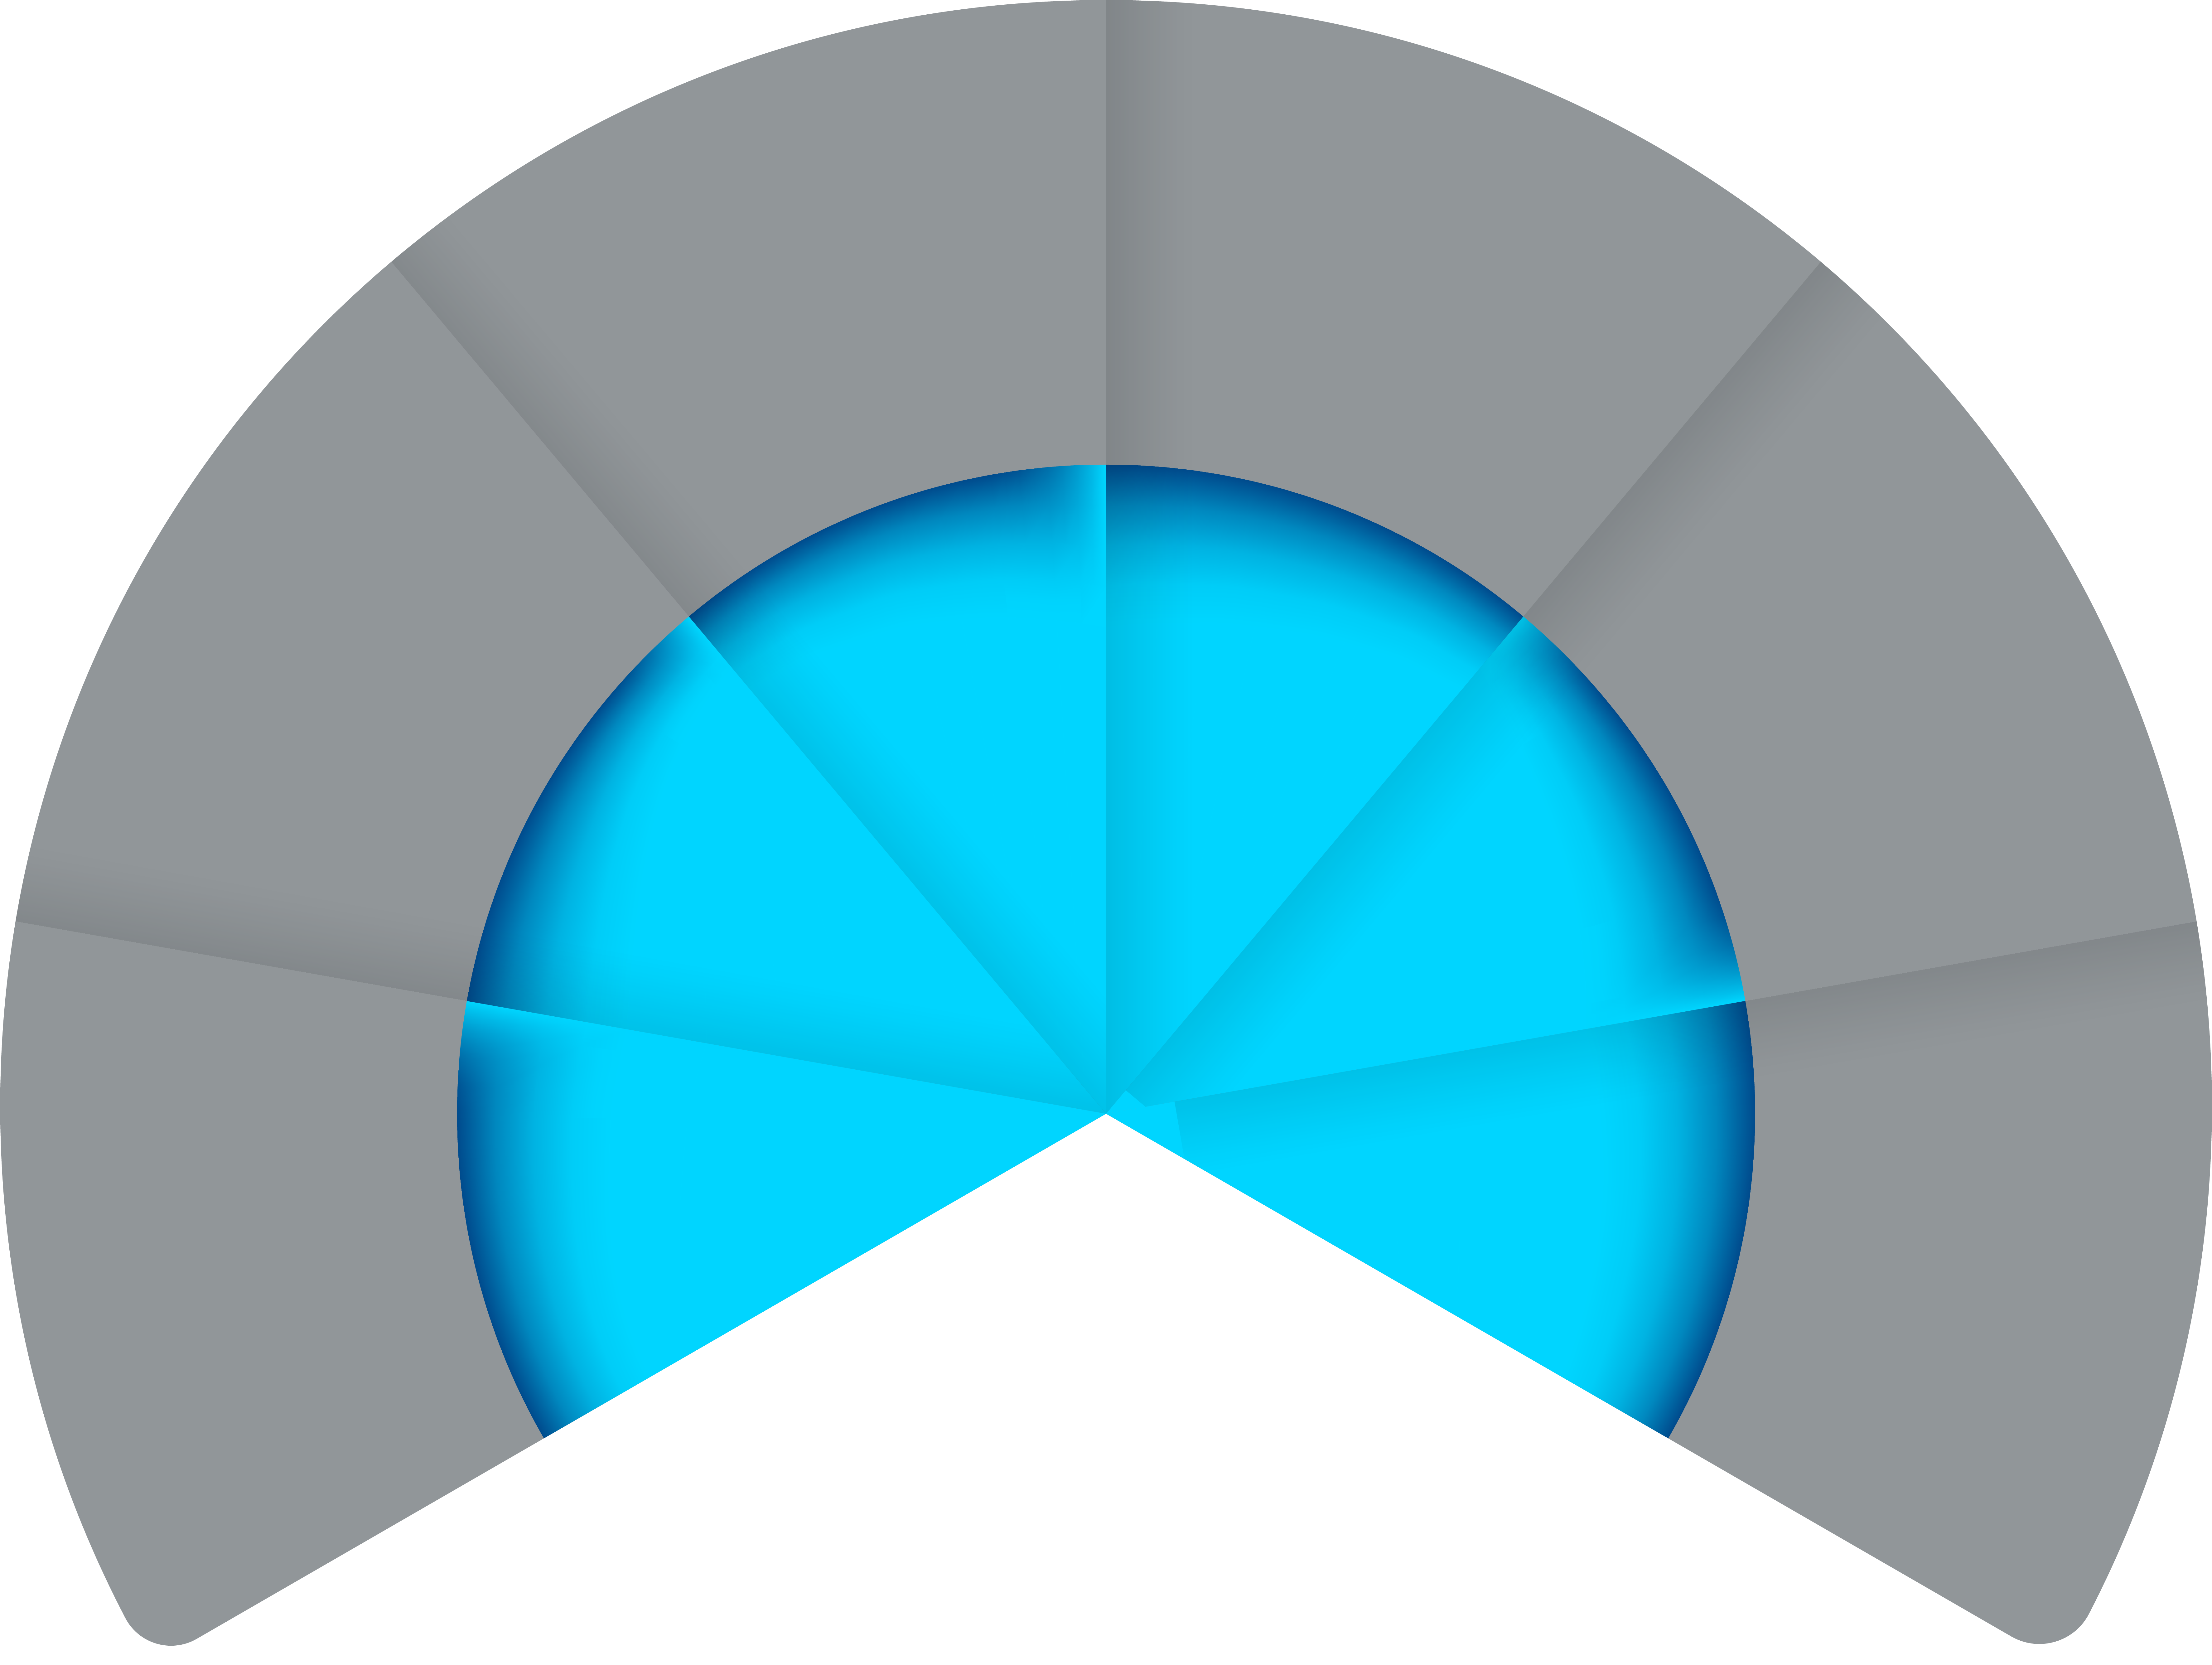





Regulatory environment | non profit funds with open enrolment and community rating | but no mandate
HEALTH FUNDS ARE NOT FOR PROFIT “MUTUALS” GOVERNED BY THE COUNCIL FOR MEDICAL SCHEMES
SIGNIFICANT ADVERSE SELECTION PRESSURES
Open enrolment; Guaranteed acceptance;
limited underwriting
Community
rating
BOARD OF TRUSTEES
Medical
Schemes
Strict solvency
regulations
>300 Prescribed Minimum Benefits
25%
Administration fees
Administration
& managed care
services

Slide 17




Schemes are governed by various rules
OPEN
ENROLMENT
GUARANTEED ACCEPTANCE & LIMITED UNDERWRITING
COMMUNITY
RATING
OLD AND
SICK MEMBERS
STRICT SOLVENCY REGULATIONS
25%
Anyone can apply
and everyone must be accepted
Cover cannot be declined or conditions permanently excluded
Max waiting periods of
3-12 months on pre-existing conditions
Every one pays the same premium
– no adjustment for
age and health status
Permitted to join, not charged more than everyone else
Schemes must retain 25% of total annual contributions as a solvency margin
UNLIKE SHORT-TERM INSURANCE, MEDICAL SCHEMES DO NOT HAVE THE ABILITY TO CHOOSE WHO TO COVER OR WHEN TO COVER EVENTS

Slide 18



Medical schemes offer different plans with different premiums
MEMBERS OF MEDICAL SCHEMES CHOOSE A PLAN TYPE ACCORDING TO THEIR NEEDS
All of these cars offer four wheels, steering, brakes and can drive from A to B
The Prescribed Minimum Benefits:
The common minimum across all plans

Slide 19

The fundamental point of medical schemes is that everyone pays the same for the same level of cover
EVERYBODY HAS DIFFERENT LEVELS OF CLAIMS
… BUT EVERYONE PAYS THE SAME
MONTHLY CLAIMS
Sick members
MONTHLY PREMIUMS
Healthy members

Slide 20

4
HOW
do schemes balance
members’ needs?

Slide 21
Cost of medical aid
MONTHLY PREMIUMS FOR A PRINCIPAL MEMBER
Highest benefits
Lowest benefits
Extensive day-to-day
Limited day-to-day
Hospital
Entry level

Slide 22




Cross subsidies create a perception gap between real and perceived value of healthcare benefits
PERCEIVE SIGNIFICANTLY LESS VALUE, CRITICAL TO THE SUSTAINABILITY OF THE SYSTEM
Proportion of members
1 in 10
Proportion of benefits
9 in 20

Slide 23
Cross subsidies create a perception gap between real and perceived value of healthcare benefits
PERCEIVE SIGNIFICANTLY LESS VALUE, CRITICAL TO THE SUSTAINABILITY OF THE SYSTEM
Proportion of members
3 in 10
Proportion of benefits
8 in 10

Slide 24
Cross subsidies create a perception gap between real and perceived value of healthcare benefits
PERCEIVE SIGNIFICANTLY LESS VALUE, CRITICAL TO THE SUSTAINABILITY OF THE SYSTEM
Proportion of members
3 in 10
Proportion of benefits
8 in 10
“Silent sick”
Derive significant value, but too costly to fund without support from healthy members
“Worried well”
Consistently perceive
poor value, but critical
to long term sustainability

Slide 25

5
HOW
does price inflation affect
medical schemes?

Slide 26
Health care costs continue to rise persistently:
Baumol effect
THE COST OF PROGRESS | US INFLATION, 1978 =100
HEALTH CARE COST INFLATION ABOVE CPI, %
College tuition
1,250
1,000
Medical care
750
500
Consumer prices
Average wage
250
100
0
1978
90
2000
12
Source: Thomson Reuters: “The Cost Disease”, by William Baumol, 2012:The Economist; WTW 2023 Global Medical Trends Survey

Slide 27
Factors driving medical inflation
01
Increasing disease burden and benefit utilisation
Increase in lifestyle diseases
Ageing population
02
New technologies more expensive
Allow for earlier diagnosis and more aggressive treatment
Enable people to live longer and need medical care for longer
New medical technologies drive up costs
03
Systemic shortages in health professionals
Increased demand drives up costs
04
Fee for service reimbursement incentivises utilisation increases
Fee for service
Defensive medicine

Slide 28
Utilisation is the key driver of the healthcare inflation differential
MEDICAL INFLATION (2023)
DRIVERS OF THE MEDICAL INFLATION DIFFERENTIAL
8.2%
Supply-side:
Fee for service system
Undersupply of doctors
New technology and procedures
New hospitals
Demand-side :
Adverse selection
Increased disease burden
Ageing
3%

Slide 29
An increasing disease burden and new technologies continue to drive the escalation in healthcare costs
Impact of new specialty drugs on healthcare costs
ONCOLOGY EXPENDITURE PLPM

Slide 30

How much does a urologist charge for a consultation?
a
R750
b
R1,000
c
R1,500
d
R2,000

Slide 31
How much does a urologist charge for a consultation?
a
R750
b
R1,000
c
R1,500
d
R2,000
These are real rates from DHMS data. Docs can charge any rate at their discretion.
Members of medical schemes are exposed to the doctors preferences in terms
of what he or she charges

Slide 32
Shortages of supply drive costs
Key challenges: Undersupply of South African doctors
DOCTORS PER 10,000 LIVES
MEDICAL GRADUATES PER 10,000 POPULATION PER ANNUM
NECESSITATES SYSTEMIC CHANGES TO OPTIMISE HEALTHCARE RESOURCES

Slide 33
Supply side pressures necessitate the need for systemic innovation
KEY CHALLENGES | CONNECTING DISPARATE PARTICIPANTS IN THE HEALTHCARE SYSTEM
Admitted to
hospital
Fragmentation in traditional healthcare delivery models result in systemic inefficiencies:
Increased risk of inappropriate treatment and suboptimal
clinical outcomes
Lack of consolidated information results in repetitive, unnecessary diagnostic treatments
Diagnostic
tests
Medical
emergency
Ordering
medicine
Visiting a
doctor

Slide 34

7
HOW
is Discovery Health Medical Scheme
tackling these issues?

Slide 35

Innovating for sustainability
Innovation in the context of sustainability
01
Requires scale
02
Must deliver better quality of care
03
Must ultimately result in savings to the scheme

Slide 36


Discovery is committed to building a better healthcare system for all South Africans
HEALTHCARE INFRASTRUCTURE
QUALITY OF CARE
1
2
Make a substantial investment in
educating new South African doctors
Leverage our scale and expertise to
support doctor-patient interactions

Slide 37
Discovery is committed to building a better healthcare system for all South Africans
HEALTHCARE INFRASTRUCTURE
QUALITY OF CARE
1
2
Make a substantial investment in
educating new South African doctors
Leverage our scale and expertise to
support doctor-patient interactions

Slide 38
A targeted intervention to address challenges in our healthcare sector
STRATEGIC PRIORITY
DISCOVERY FOUNDATION ACTION
Undersupply of specialists and sub-specialists
Urban sector bias and the need to retain/support healthcare skills in rural areas
Racial bias amongst medical professionals
Private sector bias – support for resource and skills development in the public sector
Shortage of skilled and experienced specialists to teach medical skills
Academic Fellowship Award
  Boosting clinical and academic training and knowledge in SA
Sub-Specialist Award
  Supports training of SA’s super-specialists
Rural Fellowship Award
  Grants aimed at developing and retaining specialist skills in rural areas
Excellence Award
  Monetary awards to boost healthcare resources
  for organisations
TO DATE
Invested more than R275 million towards training and support for 465 medical specialists and institutions

Slide 39
Discovery is committed to building a better healthcare system for all South Africans
HEALTHCARE INFRASTRUCTURE
QUALITY OF CARE
1
2
Make a substantial investment in
educating new South African doctors
Leverage our scale and expertise to
support doctor-patient interactions

Slide 40


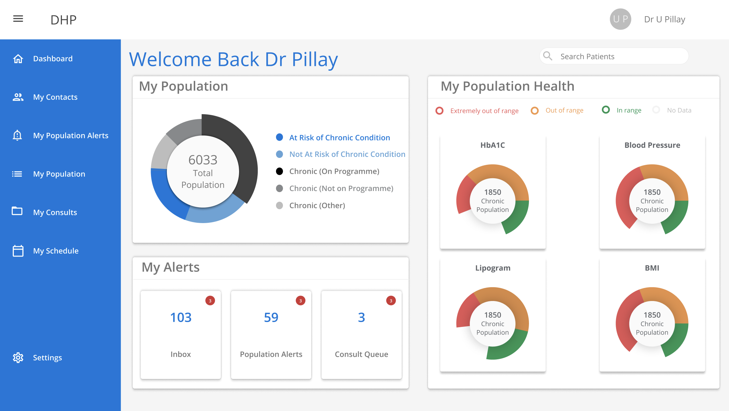




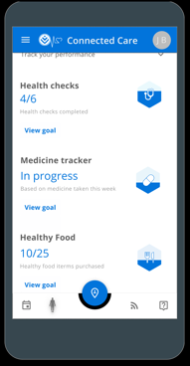




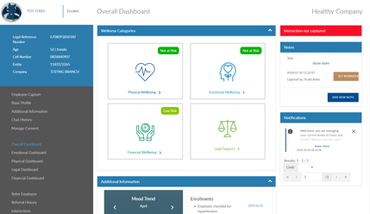




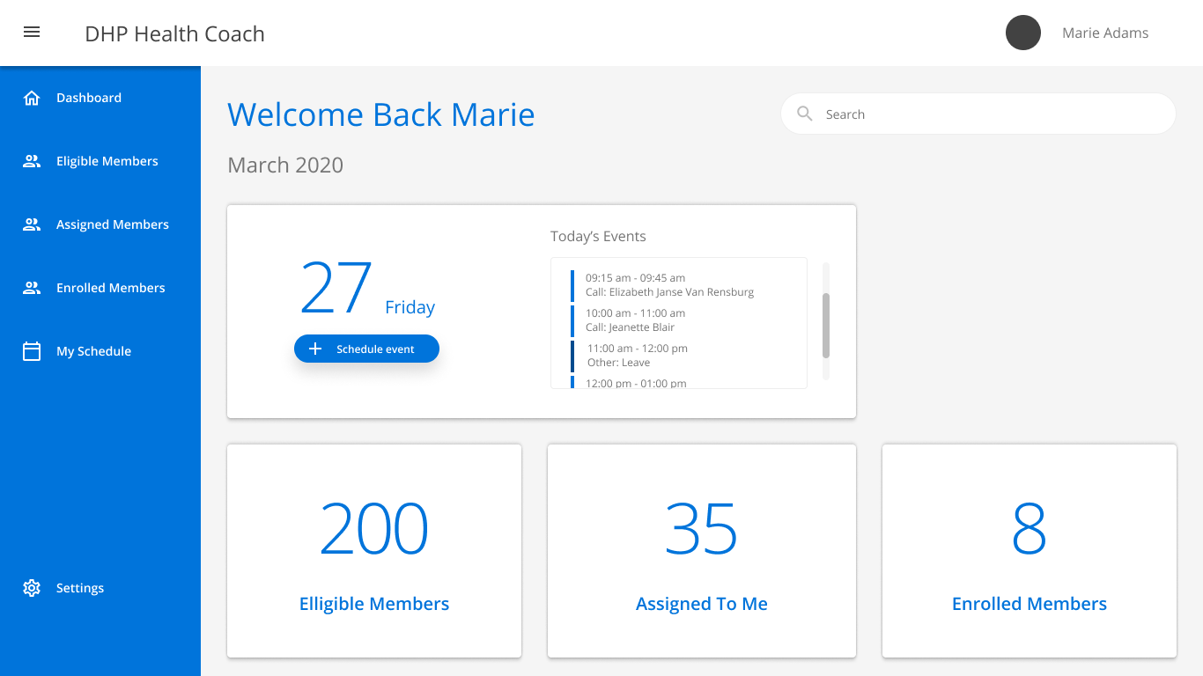


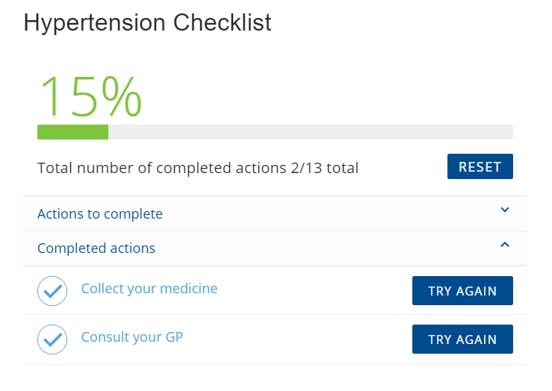






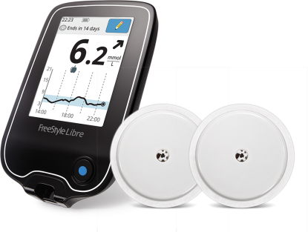



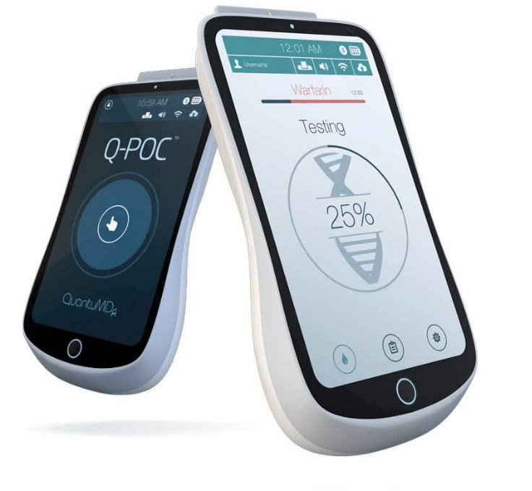
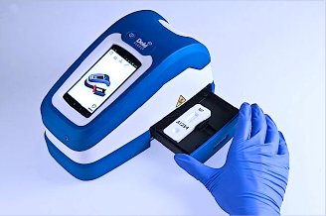



Digital Health
Ecosystem
CARE & COORDINATION
Population Dashboards
EHR
EMR
DIGITAL THERAPEUTICS
VIRTUAL CARE
COACHING
Scheduling
Population
Alerts
WELLNESS
Medicine
Tracker
Alerts
Nudges
eScripts
Personalised Health Objectives
.
CENTRIC
+
INTEGRATED
3rd PARTY
HEALTH APPS
HUMAN
PHYSICAL HEALTH
Care
Pathways
FINANCIAL HEALTH
HEALTH
PROPERTY HEALTH
BEHAVIORAL
MENTAL HEALTH
Virtual Consults
Coaching Portal
INSIGHTS & FORESIGHTS
EXPERIENCE
OPERATIONAL
self-captured
experience
Model
repository
Clinical Ref Libraries
insurance
behavioral
clinical
devices
Knowledge Repositories
DATA
MaaS
Models as a Service
operational
DEVICES
Clinical
Ontology
Groupers
Profiling & Segmentation

Slide 41








Medical scheme risk management
APPLICATIONS
NEXT GENERATION
CARE DELIVERY
Healthcare Delivery Assets
Discovery’s Hospital at Home
Discovery Healthcare Services
MedXpress
POPULATION
HEALTH MANAGEMENT
Clinical Pathways
Disease Management Programmes
DiabetesCare, Mental Health programme, CardioCare
VALUE-BASED CARE
Risk Sharing Contracts
Data Analytics and Measurements
Value Based Modifiers
Alternative reimbursement models
Provider profiles
Network participation criteria
QUALITY & CARE COORDINATION
Hospital Benefit Specialists
Quality Improvement
Care
Coordination
Governance projects
Care-coordination programmes
Hospital tariffs dossier
FOUNDATIONAL TOOLS
Billing Intelligence
ARM’s and Networks
Clinical
Governance
HTA and Formularies
Claims structures
Contracting agreements, profiles, billing rules engine, patient segmentation model
HEALTH RISK MANAGEMENT ASSETS

Slide 42
Multiple value based provider contracting models
Complexity
Capitation agreement
4
GP Value based multiplier
Each year a minimum score is established and GPs achieving the score receive a Value Based Modifier of 5% of their total base remuneration.
Global fee
3
Arthroplasty network
Global fee caps growth in arthroplasty costs (reducing LOS from 5.67 in 2015 to 4.37 in 2019)
Fixed fee
2
Coronary Artery Disease Programme
Fixed 6-week episode fee for eligible patients agnostic of type of angio undertaken (cover for CT scans)
Fee for service
+ incentive
1
Renal dialysis
Base tariff set at inflation (-1.5%) and measured quality results in payments up to 3%
Evolution

Slide 43
Driving value-based care PROGRAMMES throughout the value chain - FOR Hospitals…
Network & payment arrangement
Profiling & outlier management
Quality
of care

Slide 44
…as well as for health professionals
Network
& payment arrangements
Profiling & outlier management
Value-based governance programmes
Quality
of care

Slide 45









Quality initiatives ARE empowering patient decision making
MEASUREMENT TOOLS
Provider profiles
Patient surveys (PREMS / PROMS)
Scorecards (diabetes, primary care)
Clinical registries
Predictive outcomes models
PaSS + [Mortality+Readmission] +
[HAI + Negative Incidents]
CPE
fx
=
REPORTING
REPORTING
  Patient Mortality
  Mortality
  Readmissions
Stakeholder reporting
  HQA
  CoMS
Perception
Patient experience surveys
Efficiency
Optimising cost, case mix and admissions
Quality
Monitoring mortality and readmission for common conditions
Safety
Measurement and self-reporting of negative incidents
MEMBER EDUCATION AND EMPOWERMENT
Smart Health decisions
Quarterly publications
STAKEHOLDER MANAGEMENT
Forum participation (ITAP; HQA)
Industry Quality Summit
Publications: SAMJ Mortality
ICHOM adherance

Slide 46

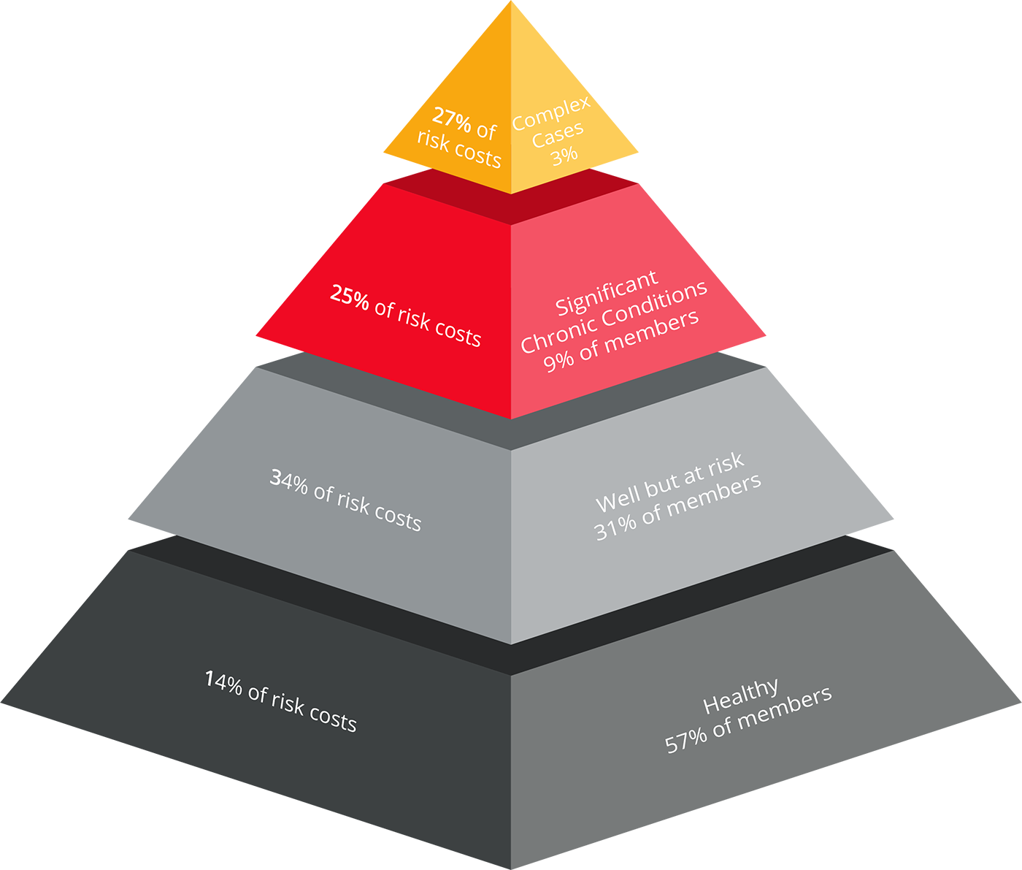





Population health management programs targeting members living with high prevalence conditions
OBJECTIVES
STRATEGIC APPROACH
PROGRAMMES
Improve the health of
the target population
25% of members, accounting for 60% of costs, are targeted for PHM programs
Prevention and management of high Impact non-communicable diseases
1
Complex cases
2
Enhance the experience of care (patient-centricity)
Oncology & end-of-life care
3
Reduce overall costs of healthcare and improve sustainability
Mental health
Success is supported by appropriate shared value payment models
(value-based care) and
improved care coordination
End stage renal failure
HIV management
Notes:
In 2023 DHMS, in partnership with health professionals, is for the first time introducing a disease prevention programme (as opposed to a condition management programme)
Explicit aim of identifying those at risk of developing diabetes and cardiovascular disease
Identified through AI driven algorithm, based on unique Discovery Health insights
Estimation of 25 000 members currently at risk
Members contacted proactively, invited to enroll in 12-month programme
Scheme funds interventions
After 12-months
exit programme if successful
Continued support for those still at risk
CIB support if condition has deteriorated

Slide 47
Comprehensive set of member and condition management programmes which effectively manage Clinical risk
Disease management
& benefit programmes
Care
coordination
Patient empowerment
Wellness

Slide 48
Vitality study shows participation in fitness related activities is associated with significantly lower healthcare costs
01
Vitality motivates people to become more active
02
Physically active members have a 7% lower chance of being admitted to hospital
03
Physically active members who are admitted to hospital incur lower costs
Source: Participation in Fitness-Related Activities of an Incentive-Based Health Promotion Program and Hospital Costs: A Retrospective Longitudinal Study
Notes:
Vitality is a leading wellness programme globally
Incentivises members to be more healthy:
426,000 members registered on gym benefit
280,000 Personal Health Reviews, 90 000 Wellness Day assessments and 88,000 Vitality Checks completed in 2011
254,000 HealthyFood™ activations to date

Slide 49

8
CLOSING

Slide 50



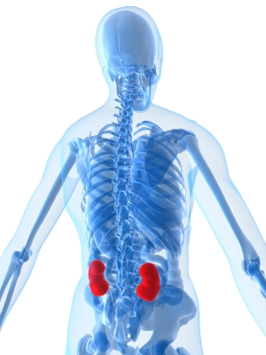















Summary
01
Healthcare is not affordable for individuals to self-fund
02
Medical schemes provide healthcare funding by pooling member contributions
03
Discovery Pty Ltd
DHMS
Administrators differ from medical schemes
04
Schemes are governed by rules
(open enrolment, community rating, guaranteed acceptance)
05
It is a challenge to balance the differing needs of members
06
High healthcare inflation is driven by many factors
07
South Africa’s healthcare issues are experienced worldwide
08
Discovery is committed to building a better healthcare system for all South Africans
Notes:
Vitality is a leading wellness programme globally
Incentivises members to be more healthy:
426,000 members registered on gym benefit
280,000 Personal Health Reviews, 90 000 Wellness Day assessments and 88,000 Vitality Checks completed in 2011
254,000 HealthyFood™ activations to date

Slide 51
Introduction to the medical schemes environment
ALAIN PEDDLE | HEAD OF R&D

