Slide 1
Rules that govern medical schemes
ROSEANNE HARRIS | HEAD: POLICY AND REGULATORY AFFAIRS

Slide 2









Rules that govern medicals schemes
The Medical Schemes Act
Open and restricted medical schemes
Role of administrators
Industry stakeholders
Section 59
Regulations 5 and 6
Confidentiality

Slide 3



Current Healthcare System
South Africans
Medical Schemes
Voluntary Contributions
No Pooling across 76 schemes
Out of pocket payments
(40% of SA households)
National Treasury
Tax based funding
National pooling -> provincial allocations
Financing/ Pooling
Defined benefit package
Defined by PMB entitlements and scheme rules
(Duplicative)
Purchased services
No explicit benefit package
Care rationed according to resources available
Benefits
Private healthcare providers
Largely Fee-for-service reimbursement
Public providers
Budget allocations
Provision

Slide 4







Regulatory environment | non profit funds with open enrolment and community rating | but no mandate
MEDICAL SCHEMES ARE NOT FOR PROFIT “MUTUALS” GOVERNED BY THE COUNCIL FOR MEDICAL SCHEMES
SIGNIFICANT ADVERSE SELECTION PRESSURES
Open enrolment; Guaranteed acceptance; limited underwriting
Community rating
BOARD OF TRUSTEES
Medical
Schemes
Strict solvency
regulations
>300 Prescribed Minimum Benefits
25%
Administration fees
Administration & managed care services

Slide 5

Provisions of the Medical Schemes Act
Establishes the Council for Medical Schemes – 15 members appointed by the Minister
Registrar appointed by the Minister
Business of a medical scheme
Only medical schemes
No other business
Responsibilities of Medical scheme trustees – 50% elected
Binding nature of the rules – must be approved
Financial management of medical schemes
Management of assets
Nature of payments
Financial soundness
Minimum benefit requirements
Limitations on underwriting
Accreditation of administrators, brokers
Complaints and appeals

Slide 6



What is a Medical Scheme
Medical schemes are not-for-profit trusts that are regulated in terms of the Medical Schemes Act.
Individual schemes are managed by independent Boards of Trustees, chosen by members of the scheme, and are independent of medical scheme administrators.
A medical scheme cannot do any other business other than what is defined in Section 1.
As a not-for-profit trust, contributions paid to the medical scheme belong to scheme members. From these contributions, medical expenses claimed by members are paid out to healthcare providers, and all other expenses of the scheme are met (e.g. broker fees, administration and managed care fees, Trustee and scheme office expenses).
Any surplus over and above what is paid out is retained by the scheme to build up reserves.
Section 1 of the MSA defines the business of a medical schemes as doing any of the following in return for collecting a contribution or premium:
Providing for obtaining a relevant health service
Defraying expenditure for a relevant health service
Rendering a relevant health service

Slide 7
Types of Medical Schemes
At the end of 2021, there were 75 medical schemes (open and restricted) registered in South Africa with the CMS, covering just under 9m beneficiaries. This amounts to coverage of approximately 15.6% of the South African population.
Discovery Health (Pty) Ltd administers:
1 open medical scheme : Discovery Health Medical Scheme
18 restricted member medical schemes
Open medical schemes
Restricted medical schemes
Any member of the public can join
Eligibility linked to criteria e.g. employment, membership of an association or union

Slide 8





The role of Discovery Health as an accredited administrator
Medical schemes are regulated by the CMS and governed by an independent, majority member-elected Board of Trustees
All contributions are pooled to fund members’ claims, and any surplus funds remain in reserves for the security and benefit of members
Discovery Health administers 20 medical schemes (1 open and 19 restricted)
Robust regulation and governance
Regulates
Members
Board of Trustees
Administrator and managed care provider
elect
Appoints / outsources to
governs
Medical Schemes
belong
services
DISCOVERY HEALTH IS AN ACCREDITED ADMINISTRATOR AND MANAGED CARE PROVIDER SUBJECT TO REGULATION BY THE COUNCIL FOR MEDICAL SCHEMES

Slide 9
















Discovery Health Universe
19
Schemes administrated by Discovery (DHMS and 18 closed schemes)
25
DHMS plan offerings available as of 1 January 2023

Slide 10
Medical Scheme Administration
01
Member record management
Administrators provide for the registration, maintenance and updating of individual member records
02
Contribution management
Administrators manage and maintain the collection and receipt of contributions to an individual member level.
03
Administrators ensure that all claims received are captured on the system, and that all legitimate claims are assessed and paid in line with the rules of the medical scheme and individual members’ benefit options.
Claims management
04
Administrators collect and collate financial and non-financial management information to comply with statutory reporting requirements, and to be in a position to provide the Principal Officer and the Board of Trustees of each medical scheme under its administration with information on scheme performance.
Financial management
05
Administrators manage the array of information generated in order to provide, co-ordinate and integrate services. The confidentiality, security and integrity of information must also be managed to protect the interests of schemes and their members.
Information management and data control
06
Customer service management:
Administrators provide members with relevant and professional customer care services.

Slide 11



















Comprehensive set of member and condition management programmes which effectively manage Clinical risk
Disease management & benefit programmes
KidneyCare
Mental Health
HIV
DiabetesCare
Oncology
HomeCare
Advanced Illness Benefit
Cardiovascular
Care coordination
Care Coordination Programme (CCP)
ElderCare
Member Care Team
Clinical care pathways
Patient empowerment
Smart Health Choices
Hospital Experience Surveys and Outcomes Measures
GP Survey
290 Procedure Guides
Cleveland 2nd Opinion Service
Wellness
HealthyCompany
Executive Wellness
Screening
Insights
Care

Slide 12

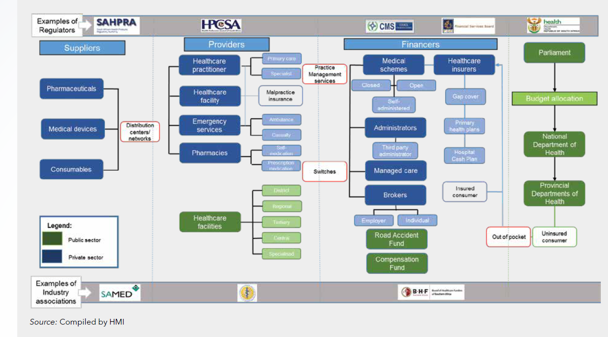
Industry stakeholders
Source: Complied by HMI

Slide 13

Healthcare Practitioner types & context
Healthcare services are provided by a range of Healthcare Practitioners such as general practitioners, specialists, nurses, pharmacists and other professionals
Healthcare practitioners are subject to regulation by various professional regulatory bodies
Medical practitioners generally operate individually in their own private practices
There are some ‘group’ practices – however these groups are confined to practitioners belonging to the same discipline
Some medical practitioners form corporate practices, such as pathologists and radiologists
Most practitioners are paid using a fee for service model
There are over 36,000 practitioner practices operating across medical schemes – of which approximately 8,000 are GP practices and 7,000 are specialist practices

Slide 14
SECTION 59 | ITS APPLICATION TO PROVIDERS
Section 59 provides as follows –
A supplier of a service who has rendered any service to a beneficiary in terms of which an account has been rendered, shall, notwithstanding the provisions of any other law, furnish the member concerned account or statement reflecting such particulars as may be prescribed.
A medical scheme shall, in the case where an account has been rendered, subject to the provisions of this Act and the rues of the medical scheme concerned, pay to a member or supplier of service, any benefit owing to that member or supplier of service within 30 days after the day on which the claim in respect of such benefit was received by the medical scheme.
(3) Notwithstanding anything to the contrary contained in any other law a medical scheme may, in the case of –
Any amount which a member or a supplier of the health service is not entitled to; or
Any lost which has been sustained by the medical scheme through theft, fraud, negligence or a
misconduct which comes to the notice of the medical scheme……
deduct such amount from any benefit payable to such a member or supplier of health service.
The wording of Section 59 deals with how claims are submitted, to whom claims may be paid, by when they must be paid and how claims paid bona fide in error to a service provider (with no element of fraud present), to a loss sustained by a medical scheme through theft, fraud, negligence or other misconduct may be dealt with.
The provisions of Section 59 are thus not empowering provisions. They simply circumscribe how medical schemes must exercise its powers and obligations when conducting its business to pay claims as per paragraph (b) of ‘the definition of ‘business of a medical scheme’.

Slide 15




Claims processing
Majority are now digital incl direct payment arrangements
Taken at face value
Claims are received through multiple channels
Minimum information requirements met (Reg 5)
Eligibility for coverage – scheme rules, member benefits, authorisations
Payment made to provider or member (Reg 6)
High level of complexity
Majority of claims on a 4-5 day turnaround

Slide 16
Breakdowns of FWA cases
DISTRIBUTION OF PRACTICES BY FWA STATUS 2021
FWA CASES 2018-2020
THE MAJORITY OF INVESTIGATIONS ARE FOR SERVICES NOT RENDERED OR CLAIMING FOR PRODUCTS NOT PURCHASED

Slide 17
Sound financial management necessitates the review of claims
Fraud, waste and abuse is a key challenge for medical schemes and drives up the cost of cover
Ongoing claim analytics
Requires
co-operation
Anomaly detected
Collect information
Investigation process
Process outcome e.g. recovery of claims
Complaints and tip-offs
All recovered funds paid into medical schemes

Slide 18

Industry code of Good practice
Challenge of definitions – issue of intent and obligation to be aware of requirements
Issues of consent:
Requirement for submission of claims information – right to be informed
Role of accredited administrators
All parties to exercise reasonable management controls
Obligation to report irregularities
Detection processes
Reasonable processes for algorithm development
Random processes should not be excluded
Reporting
Identification of practices may not always be appropriate
Requirement for reporting to regulators/authorities under specific circumstances
Professional societies are important partners in encouraging ethical practice
SID is a separate matter
Issue of consent – healthcare practitioner needs to disclose relevant information to substantiate the claim, already needs consent for submitting a claim
Direct payment arrangements – legally upheld that there is no obligation for direct payment – only mechanism to protect scheme

